Slide 1


Slide 2

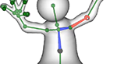

RigMesh: Automatic Rigging for Part-Based Shape Modeling and Deformation
Péter Borosán
Ming Jin
Doug DeCarlo
Yotam Gingold
Andrew Nealen
Notes:
Good afternoon, everyone.
Today we are going to show you RigMesh, a system that unifies the modeling and rigging stages in state-of-the-art 3D modeling and animation pipeline.
We can create complex shapes with just a few basic operations of sketching, cutting and merging
And better yet, the shapes can be deformed at any step of the modeling process.
[click]

Slide 3
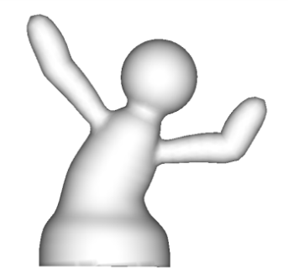
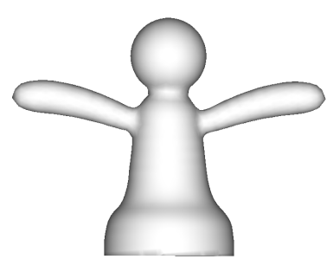
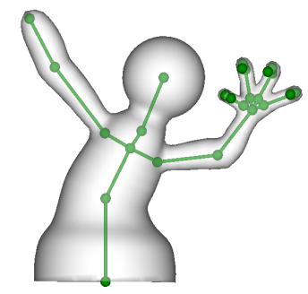
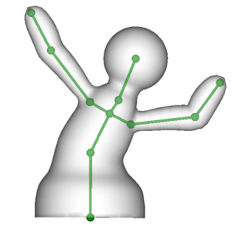
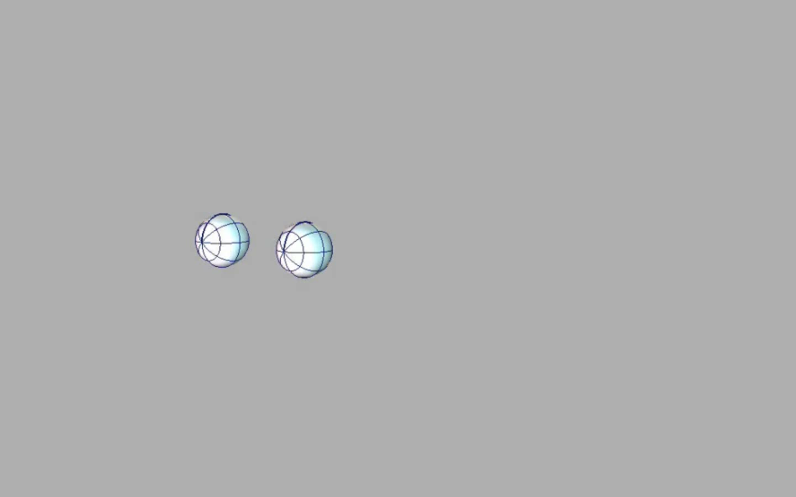
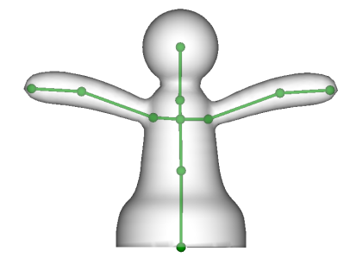
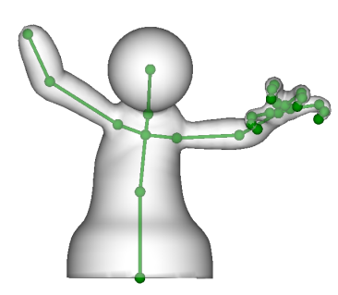
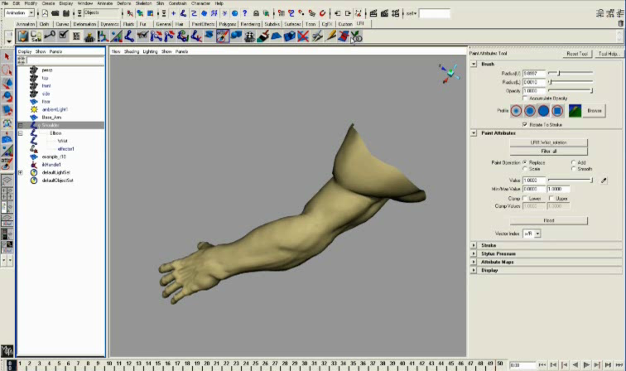
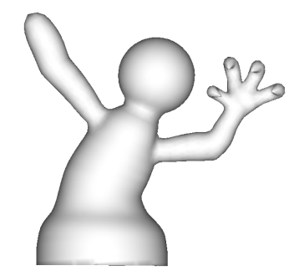
Problem
Creating ready-to-animate 3D models is hard
Modeling
Rigging
rig
deform
Fundamental problem: static sequential pipeline
[MasahiroUshiyama]
[Weber et al. 07]
Notes:
Let’s start by looking at the problem in the state-of-the-art and why we think this work is important.
[click]
First of all, creating ready-to-animate 3D models is fundamentally hard.
This whole process is broken down into modeling and rigging.
[click]
In professional modeling tools, modeling the surfaces is usually performed manually.
The artist starts with coarse subdivision surfaces or parametric patches and slowly works out all the details.
[click]
Rigging is another process in which the artist has to design the skeleton and specify the its mappings to the model.
It is a laborious process which takes a lot of tries and fails until finally a satisfactory design is achieved.
[click]
Here is an overview of the pipeline in a nutshell.
[click]
The artist creates a 3D model
[click]
She rigs the model by designing the skeleton and painting the skin weights
[click]
The resulting shape is fully rigged and ready for skin deformations by skeletons. Everything seems fine.
But what if the animator wants to change the model after it’s been rigged?
[click]
For example, she wants to change the puffy hand into a claw?
Any changes like this will invalidate the existing rig
[click]
Requiring that the model be fed back into the pipeline again
[click]
The fundamental problem here is the static pipeline where modeling and rigging have to be performed sequentially
[click]

Slide 4
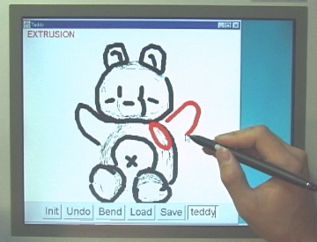
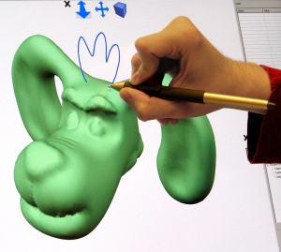
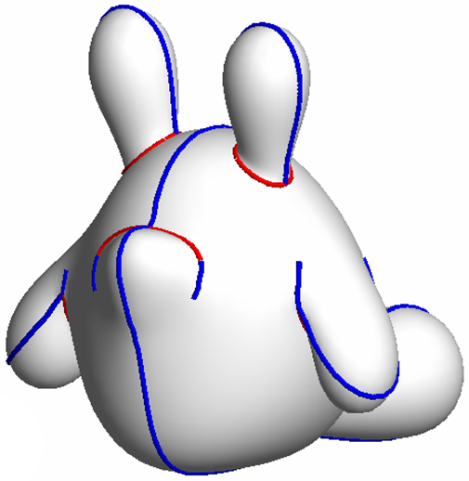
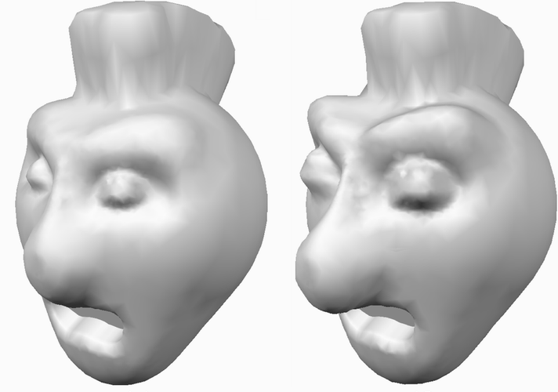
Sketch-based Modeling
Teddy [Igarashi et al. 99]
ShapeShop [Schmidt et al. 05]
FiberMesh [Nealen et al. 07]
SurfaceTrees [Schmidt and Singh 08]
Notes:
Recent advancement in the literature has provided various ways to simplify both modeling and rigging.
Noticeably, sketch-based 3D modeling has been a popular research field. It provides an easy-to-use interface and enables rapid iterative prototyping.
[click]
For example, the seminal paper on Teddy describes the creation of freeform 3D models from scratch.
[click]
As extensions to such freeform modelers, other researchers have proposed to use variational implicit functions for the underlying shape representations, such as the BlobTree in ShapeShop by Schmidt and co-workers.
[click]
Later, FiberMesh demonstrated how to integrate 3D control curves into sketch-based modeling tools. The curves on the surfaces serve as handles for controlling the geometry.
[click]
Because a single sketch usually does not suffice for creating a complex shape, there has also been interesting work on part based modeling, such as layered surface composition using Surface Trees.
[click]

Slide 5
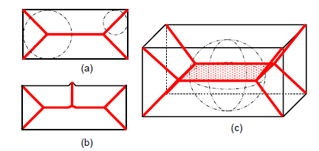
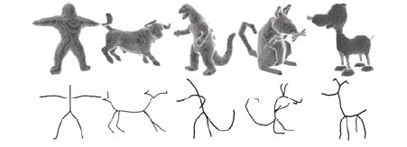
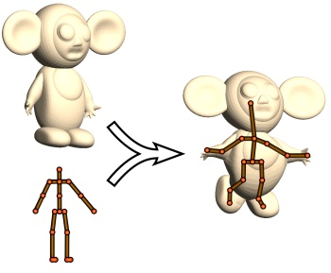
Automatic Rigging
Skeleton extraction
  [Sharf et al. 07] [Pan et al. 09] [Ju et al. 11]
  [Cornea et al. 07]
  Automatic skinning
Pinocchio [Baran and Popović 07]
Notes:
While sketch-based tools simplify the process of modeling, there also exists work in the literature that inspires automatic rigging on finished models.
[click]
Skeleton extraction is a well-studied problem in different communities such as vision, psychology and graphics.
[click]
For example, Cornea and co-workers surveyed a lot of work from generating 2D medial-axes, 3D medial surfaces to 3D curve-skeletons.
[click]
On the other hand, if the skeleton topology is known, 3D models can be rigged using skeleton embedding and automatic skinning. For example, the Pinocchio system proposed an automatic skinning method using heat diffusion.
[click]

Slide 6
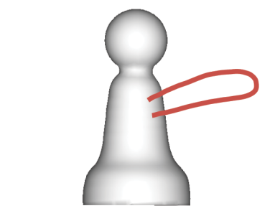
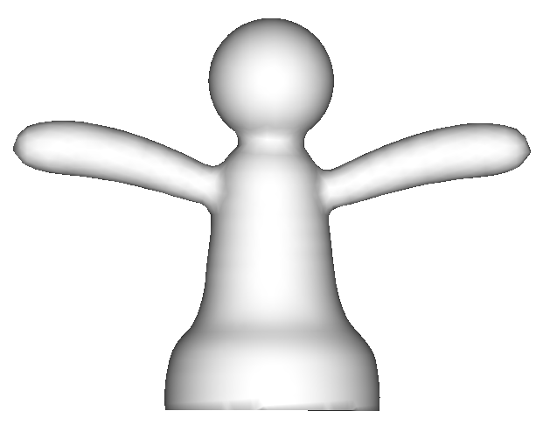
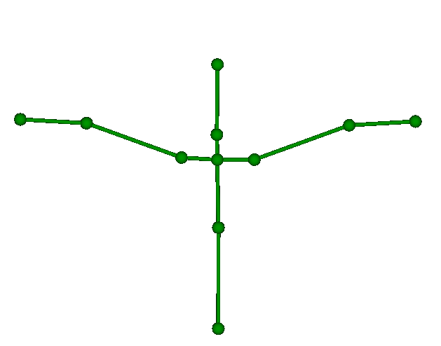
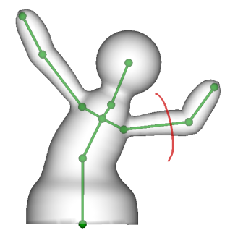
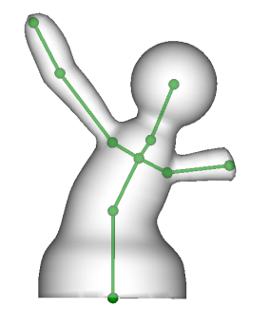
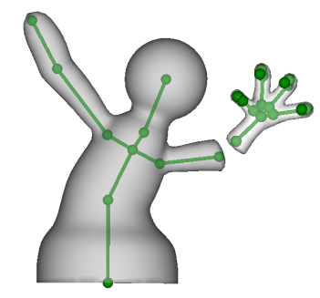
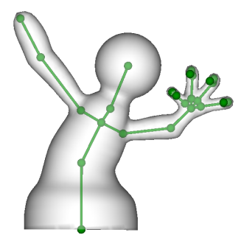
Solution?
Solution
rig
deform
Models rigged at all times
  Non-linear editing
  Modeling by parts
Notes:
Now, if we take a look again at the previous pipeline, can we use these existing methods to solve the problem?
[click]
For example, we can use sketch-based modeling such as FiberMesh for the modeling part
[click]
and use automatic rigging such as Pinocchio for the rigging part?
[click]
Unfortunately, this still does not change the linearity of the pipeline.
Also the automatic rigging methods are typically not fast enough for real-time interactions
We want animators to rapidly iterate on their designs. In order to do this, they shouldn’t have to go through the entire pipeline
[click]
Here is the solution we propose:
In order to break the sequential pipeline, the model should be rigged at all times.
[click]
As a result of that:
The animator can perform non-linear editing in terms of modeling, rigging and deformation
[click]
She can also model by parts;
Here is what the whole modeling process should look like.
[click]
After shape creation the model is already rigged
[click]
The animator can freely pose and change the model
[click]
For example, if she’s not satisfied with the hand, she can remove it use a cutting operation
[click]
And replace it with a new part by using the merging operation
[click]
All of these operations should happen in real time
[click]

Slide 7
RigMesh
Contributions
  : Sketch, Cut & Merge
Automatically determining skeletal structure from sketch
Models rigged at all times
  Non-linear editing
  Modeling by parts
Efficient local skin weights computation
Notes:
Here are our contribution in light of the proposed solution:
[click]
In addition to enabling non-linear editing, the animator can model by parts using three basic operations of sketching, cutting and merging;
[click]
We propose a method for automatically determining the bone skeleton from the user sketch; specifically determining the number and placement of the joints, which is the key issue in our system for controls and degrees of freedom;
[click]
Because the shape can be locally changed using operations like cutting and merging, we need to come up with a method for updating the skin weights in real-time, without globally re-skinning the whole shape.
[click]

Slide 8
Demo
Notes:
Now I’m going to show you an interactive demo:
So this is the RigMesh system. You can create a 3D model by sketching its silhouette, like in Teddy or FiberMesh.
The big difference is that the shape is already rigged. You can deform it using IK with our peeling interface. This is a simple operation in our system because the shapes are rigged at all times.
Now let’s say you already have some existing models, for example a chess piece. You can try out your different ideas by sketching, cutting and merging.
Let’s sketch some arms for this chess piece… and make a copy of it.
If you want to merge the arm with the body, you can either merge by snapping existing joints, or by adding a new joint and snapping there; you can also merge by inserting a new bone.
You can also change the existing skeleton topology by inserting new joints.
Let’s attach the arm this way… and pose the shape.
Now during posing, you might notice that the shape would look better if we made some changes to it. For example, you might want a claw instead a puffy hand.
Let’s cut it out, and replace it with something else. I already have a claw so let’s load it in… and merge it.
Do the same thing for the other arm.
And pose the shape a little bit more.
So you see our tool is especially useful for rapid prototyping, trying out different ideas when you don’t even have a specific design goal in mind.
[after demo]
Thanks a lot for your attention. I will now hand it over to Peter.

Slide 9
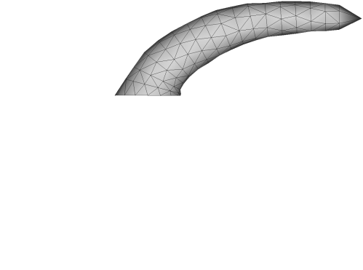
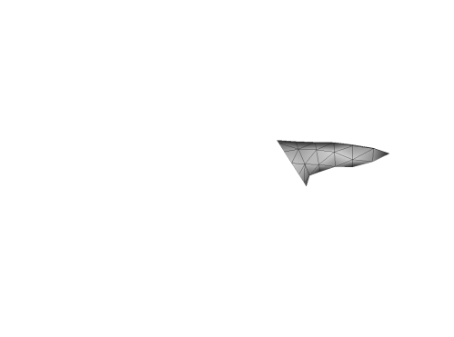
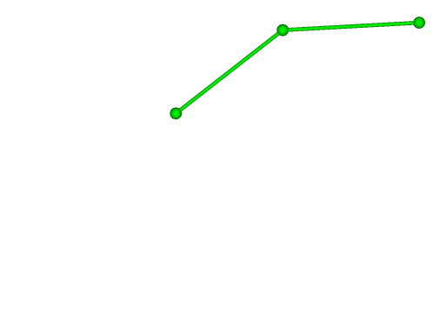
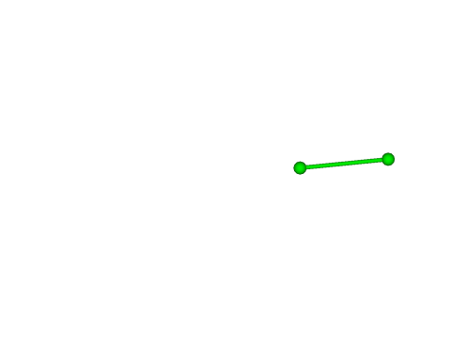
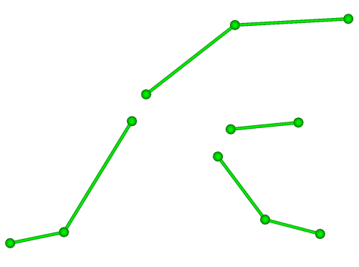
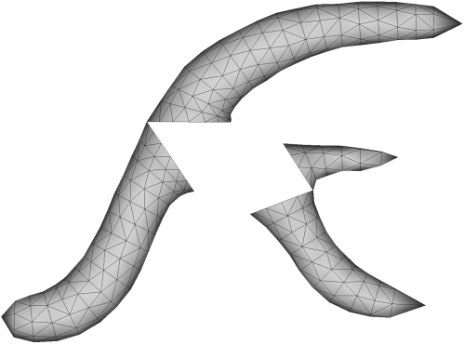
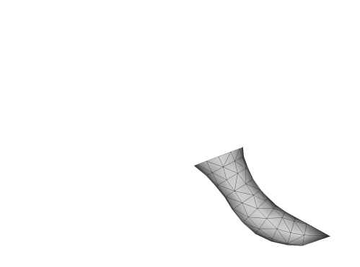


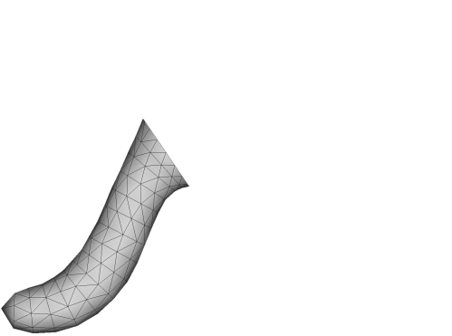
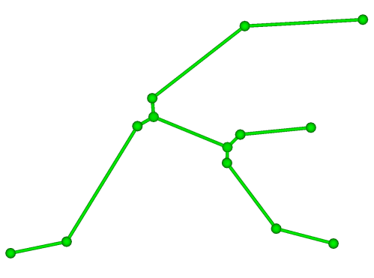
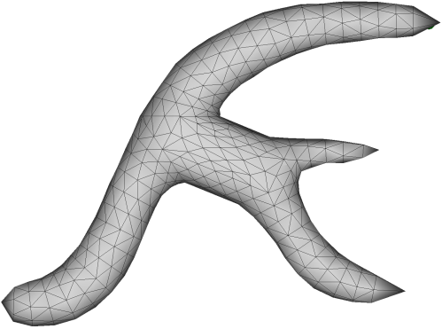
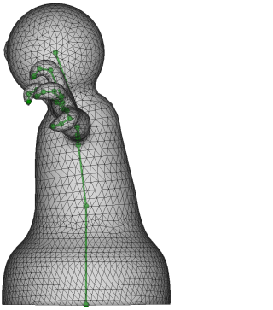
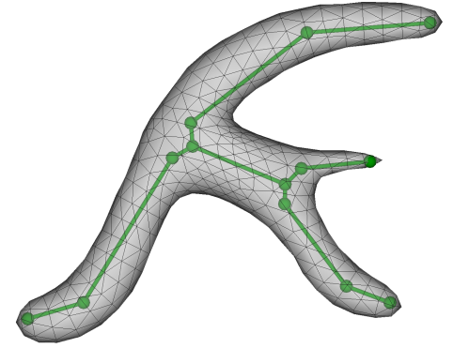
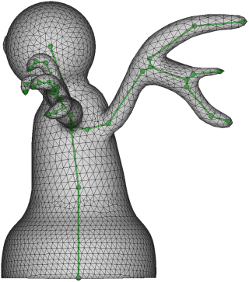
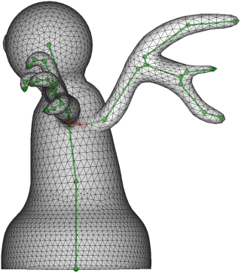
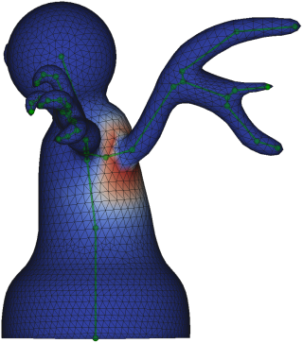
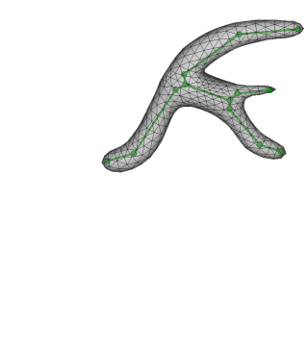
Shape creation
Notes:
Thank you. So let’s see what’s going on behind the scenes.
Let’s start with the shape creation.
To create a new shape the user sketches the silhouette of the desired 3D shape, and our system generates a surface composed of smoothly joined generalized cylinders, a skeleton, and skin weights attaching the surface to the skeleton.
First The user’s sketched curve is closed and treated as a planar polygon
[click]
and then chordal axis transform is applied to this polygon, by refining the results we obtain a decomposition into cylindrical regions [click] with well defined local symmetry and connecting regions lacking such symmetry. These regions are then treated in a different way.
For the cylindrical regions high quality skeletons are extracted using a modification of the DP algorithm, and generalized cylinder surfaces are created by using the 2D local symmetry axes as cylinder axes.
Then using the information from the connecting regions the skeleton parts are connected to create an easy to use low DOF skeleton
Similarly generalized cylinder surfaces are connected at connecting regions resulting in a watertight mesh.
The surface is then attached to the skeleton by computing smooth skin weights following the Pinnochio method of Ilya Baran.
This skinning algorithm has two parts: bounding the surface vertices to bones of the skeleton and ensuring a smoothness by solving a Laplacian system. The bounding for vertices are trivially known for vertices in cylindrical regions, so it only has to be computed for vertices on connecting regions.
The user can then combine the resulting model with an existing one. The surfaces and skeletons are merged, and the skin weights must be updated. While the same algorithm could be used again, it slows considerably as the complexity of the shape increases. We made the crucial observation that only the skin weights of vertices near the merge boundary, a small fraction of all vertices are noticeably affected. This allows for a local skin weight re-computation that greatly accelerates the process.
Because of the time constraint, now I will talk about the details of the skeleton construction for the cylindrical regions, if interested the other steps can be found in our paper.

Slide 10
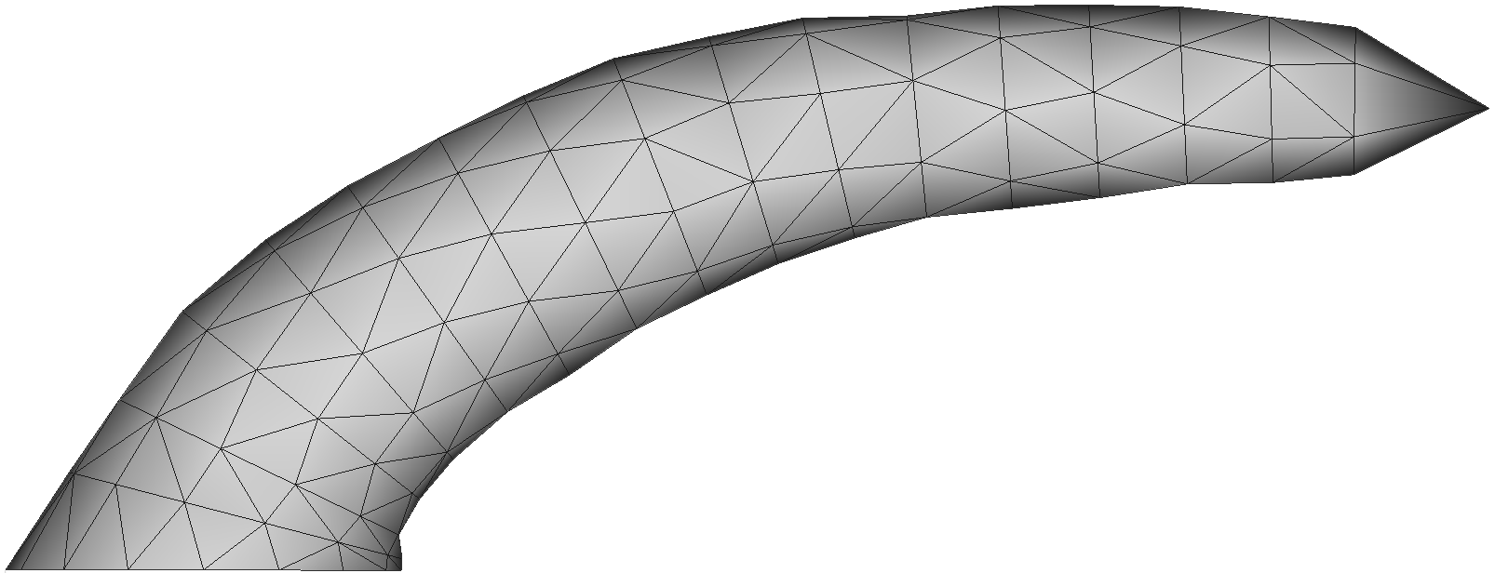
Skeletonization
Notes:
The 3D surface is created by using the 2D local symmetry axes of the cylindrical regions as the axes of generalized cylinders. This is the surface for which we need a bone skeleton. It should obviously have a linear structure, so the question is how many joints we should have and how they should be placed
The generalized cylinders are then created by using the chordal axis as the cylinder axis, and the chords as the cross sections
10

Slide 11
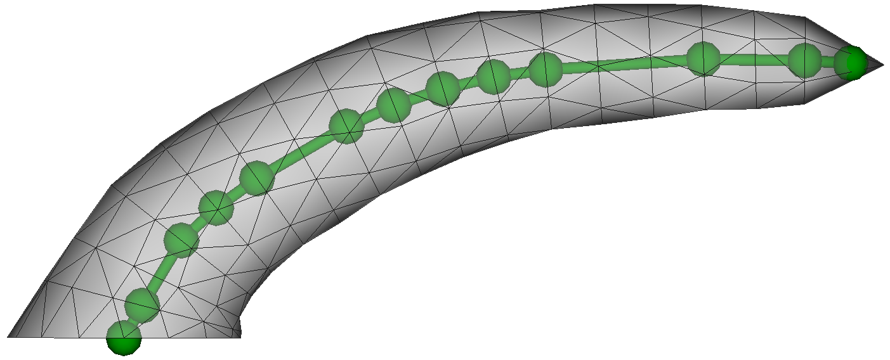
Skeletonization
Notes:
One way to go is having many joints and this way many degrees of freedom.
But then posing becomes tedious using forward kinematics, and if we use IK deformations may occur in regions that we would want to stay rigid.

Slide 12
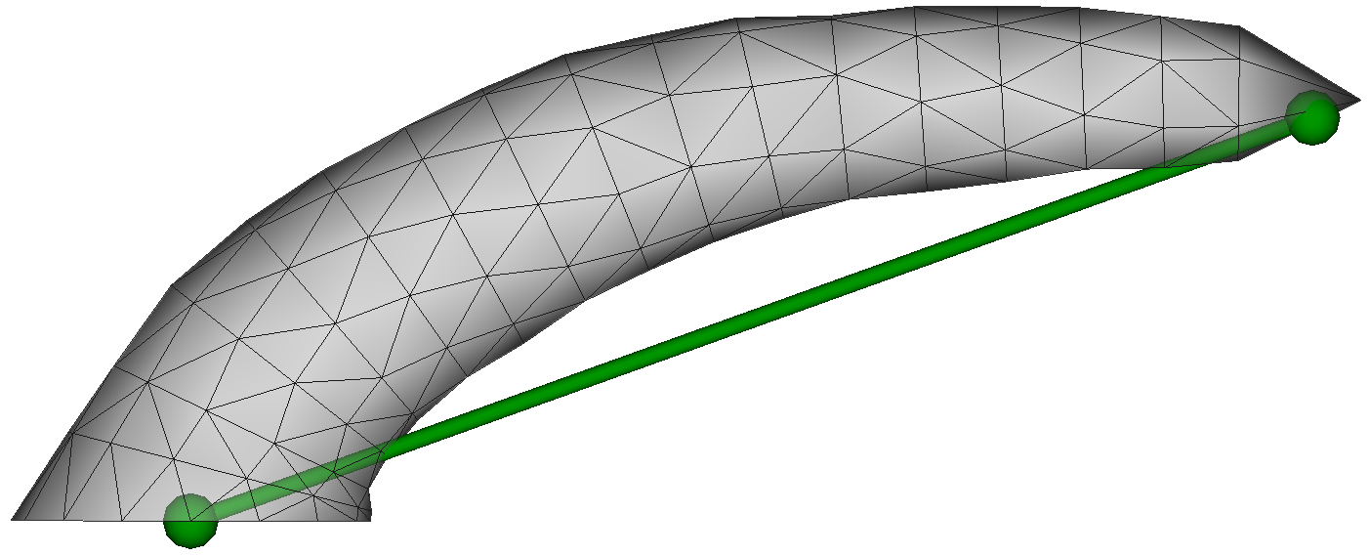
Skeletonization
Notes:
The other corner case is using a single bone for the entire cylindrical regions. This way however the whole cylindrical stays rigid, we can only pose it relatively to the connecting region

Slide 13
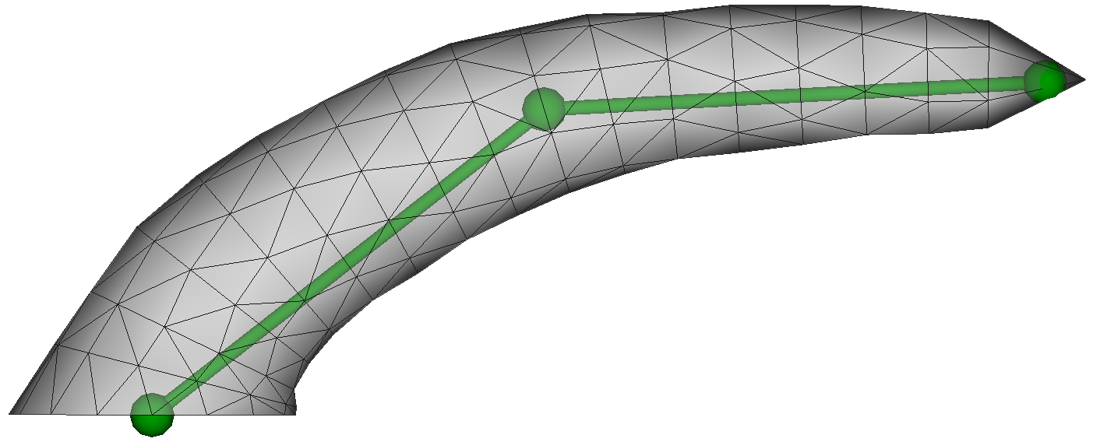
Skeletonization
Notes:
So we have to find a balance between these edge cases, we have to find a tradeoff between usability and the number of degrees of freedom

Slide 14
Skeletonization
Notes:
So what do we have to work with? For each cylindrical region the local symmetry is described by the chords and the chordal axis.

Slide 15
Skeletonization
chordal axis
Notes:
The chordal axis is an approximation of the local symmetry axis

Slide 16
Skeletonization
chord
Notes:
And the chords tell us the thickness of the region along the axis

Slide 17
Skeletonization
Notes:
The end points of the chords are approximately symmetric point pairs on the sketch.
The chordal axis represents well the 3D surface, so we use it for creating the bone-skeleton.
Since bones are straight, parts of the shape corresponding to a single bone should also be roughly straight.
The bone skeleton then can be constructed by down sampling the chordal axis to line segments. A popular algorithm for such poly-line simplification is the DP algorithm

Slide 18
Douglas-Peucker algorithm
Notes:
Recall, the DP algorithm is a greedy recursive algorithm.
It down samples the input poly line represented by a series of points, such that all of the original points lie within a predetermined error threshold of the resulting poly line

Slide 19
Douglas-Peucker algorithm
Notes:
A line segment is fit between the first and last points

Slide 20
Douglas-Peucker algorithm
Notes:
If all the other points are within the threshold of this segment, then it’s a good enough approximation and the algorithm stops, otherwise

Slide 21
Douglas-Peucker algorithm
Notes:
The point farthest from the line segment is chosen and two recursive calls are made, one for the polyline between the first and the chosen point and another one for the polyline between the chosen point and the last point.

Slide 22
Douglas-Peucker algorithm

Slide 23
Douglas-Peucker algorithm

Slide 24
Douglas-Peucker algorithm

Slide 25
Douglas-Peucker algorithm

Slide 26
Douglas-Peucker algorithm

Slide 27
Douglas-Peucker algorithm
Notes:
When all points are within the threshold

Slide 28
Douglas-Peucker algorithm
Notes:
The algorithm stops

Slide 29
What happens if…
Notes:
But what happens if we have a shape like this

Slide 30
…the chordal axis is almost straight
Notes:
Where the chordal axis is almost straight, but the thickness varies substantially along the chordal axis

Slide 31
Result of Douglas-Peucker
Notes:
Applying DP would result in a single line segment, therefore the skeleton would have a single bone, even though we feel that a shape like this does in fact have two parts, and therefore the skeleton should have two bones connected at a joint at the minimum thickness

Slide 32
Result of Douglas-Peucker
Notes:
We can lower the error threshold to get more line segments, but the additional joints are not placed at the desired location

Slide 33
Result of Douglas-Peucker
Notes:
But instead at sort of random locations according to noise and slight perturbations in the chordal axis. This shouldn’t really be a surprise, since we didn’t use information on the thickness

Slide 34
Use thickness (chords)
34
Notes:
So to alleviate this problem we extended the DP algorithm to also use thickness information from the chords. So instead of approximating the chordal axis with a poly line we are approximating the entire cylindrical region with symmetric trapezoids.

Slide 35
Fit line segment
Notes:
So the recursive function is modified in the following way:
First a line segment is fit between the midpoints of the first and last chords

Slide 36
Fit trapezoid
Notes:
And then a symmetric trapezoid is also added using the line segment as its symmetry axis, and the bases of the trapezoid are determined by projecting the first and last chords onto the normal direction of the segment.

Slide 37
Fit trapezoid
Notes:
Then we have to evaluate if it this trapezoid is a good approximation of the cylindrical region.

Slide 38
Cylindrical Douglas-Peucker error
Notes:
We define the error at each chord as the sum of the squared distances between the end points of the chord and the two sides of the trapezoid.

Slide 39
Cylindrical Douglas-Peucker error
39
Notes:
We compute the error at each chord

Slide 40
Cylindrical Douglas-Peucker error
40

Slide 41
Cylindrical Douglas-Peucker error
41

Slide 42
Cylindrical Douglas-Peucker error
42

Slide 43
Cylindrical Douglas-Peucker error
43

Slide 44
Cylindrical Douglas-Peucker error
44

Slide 45
Cylindrical Douglas-Peucker error
45

Slide 46
Cylindrical Douglas-Peucker error
46

Slide 47
Cylindrical Douglas-Peucker error
47

Slide 48
Cylindrical Douglas-Peucker error
48

Slide 49
Cylindrical Douglas-Peucker error
49
Notes:
If the maximum is greater than the predefined threshold

Slide 50
Add new point
Notes:
Then we take the midpoint of the chord, and recursively call for the parts before and after this chord

Slide 51
Fit trapezoids
Notes:
We fit trapezoids again

Slide 52
Error below threshold
Notes:
And if the errors are below the threshold, the algorithm terminates

Slide 53
Bones
Notes:
and the axes of the trapezoids are used as the bones of the skeleton

Slide 54
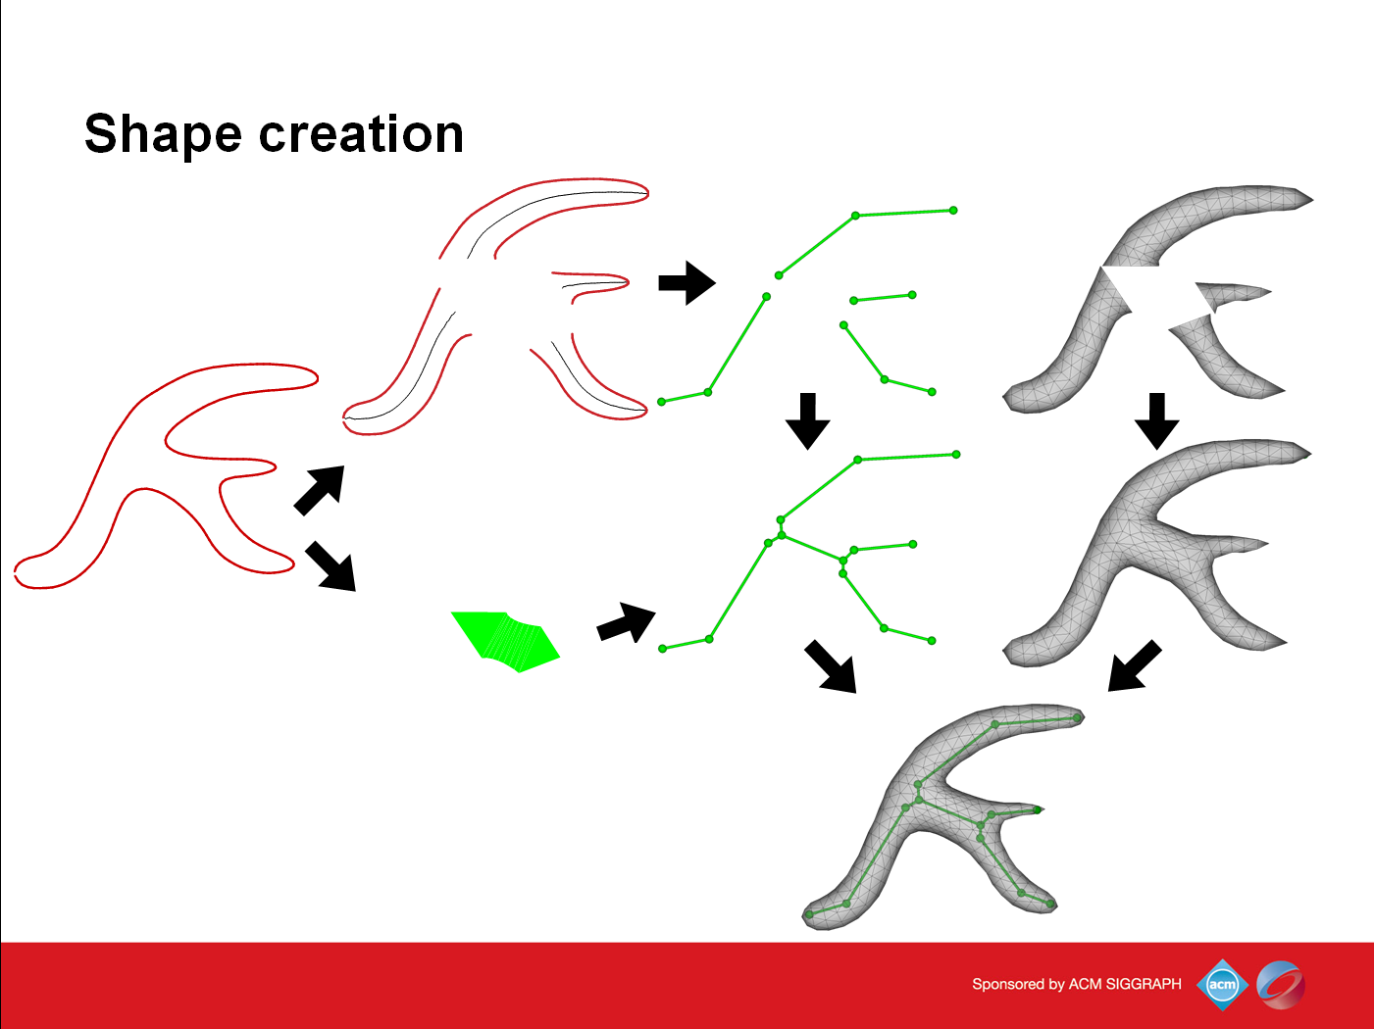

Slide 55
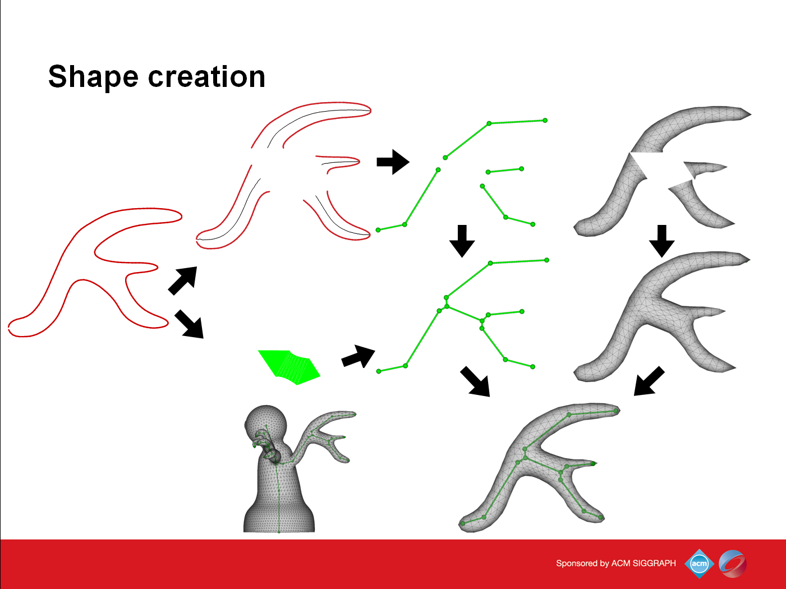
55

Slide 56
Splitting

Slide 57
Collapsing
Click
Draw lines, maybe separate

Slide 58
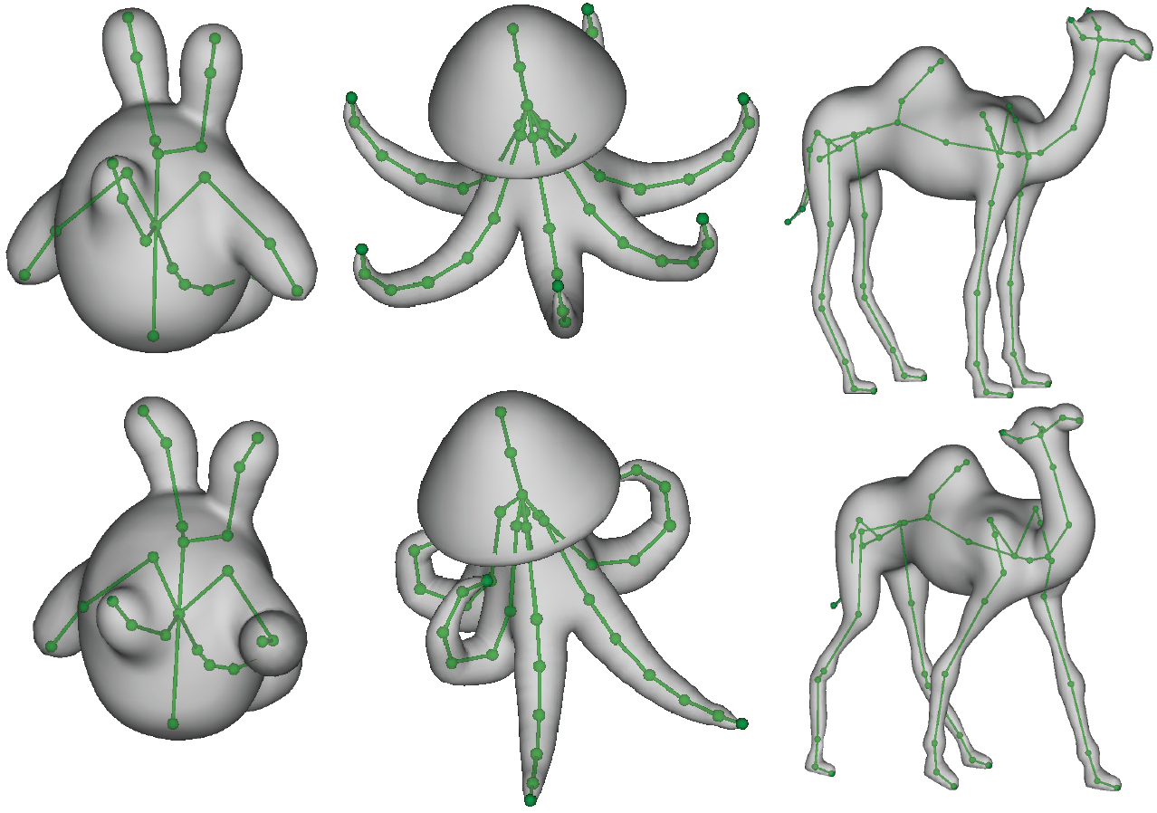
Results

Slide 59
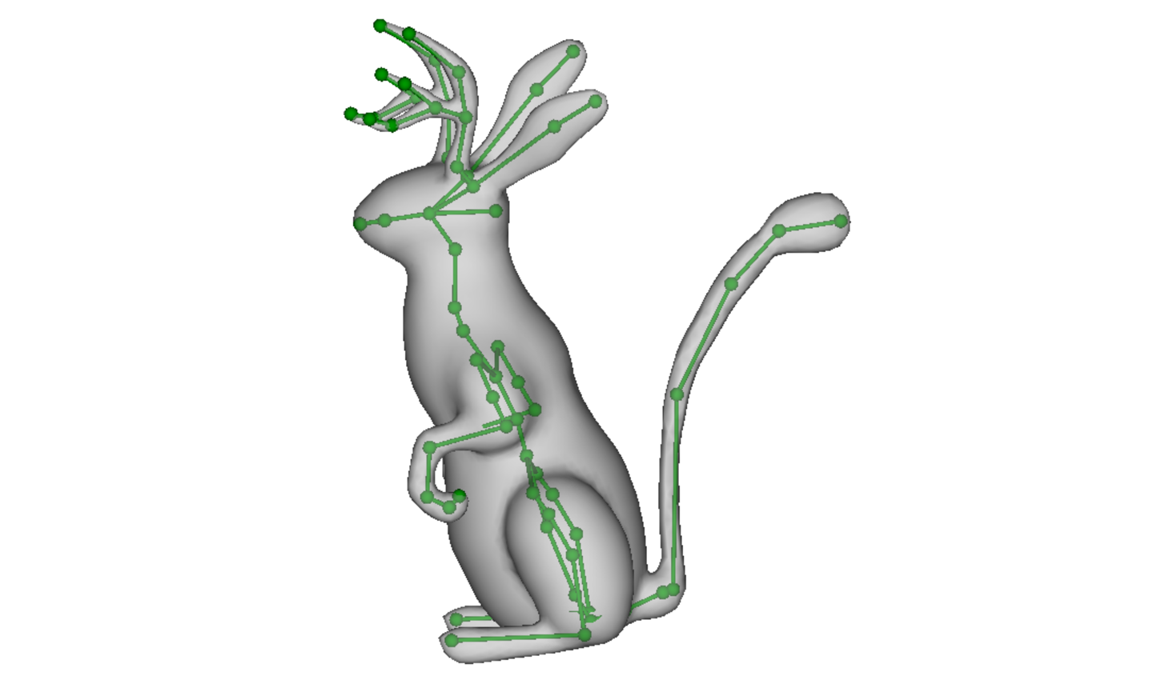
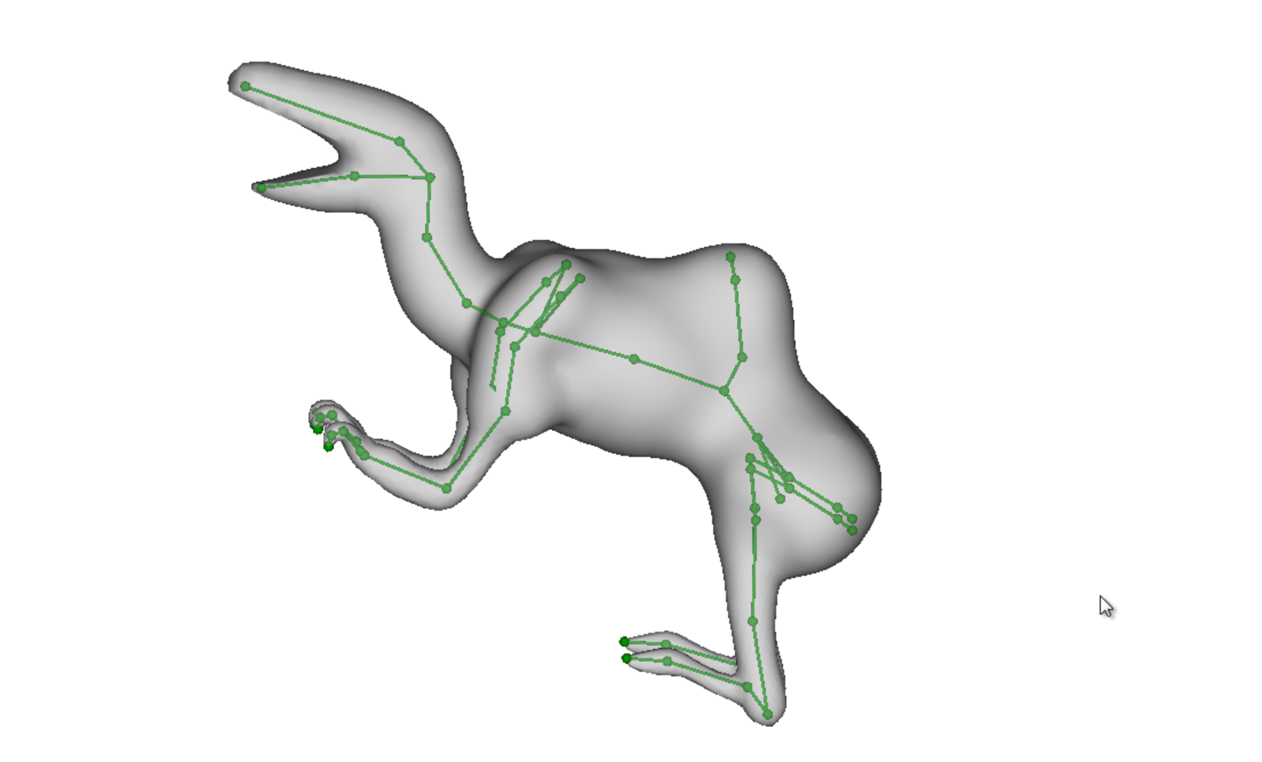
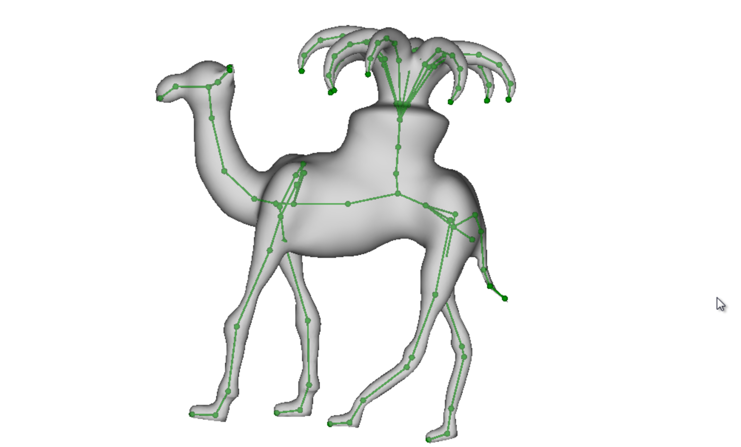

Results (reusing existing models)

Slide 60

Results (1st time users)

Slide 61
Conclusions
Unified approach to modeling and rigging
Algorithm for creating high quality skeletons for sketched shapes
Methods for locally re-computing skin weights
Modeling by parts
Notes:
To summarize our contributions
Rigmesh presents a unified approach to modeling and rigging in contrast the traditional sequential
This is achieved by maintaining a rigged mesh throughout the modeling process.
Our tools provides an easy to use interface for modeling relatively complex shapes following the idea of modeling by parts.
In addition to being accessible to novices, our tool is advantageous for rapid iterative prototyping and base mesh creation. And the created base meshes can be further refined in other tools.
RigMesh unifies modeling and rigging: the model is always rigged, and the artist can pose freely allowing for iterative modeling, deformation and key-frame animation with real time response.
To achieve this we extended the DP algorithm for creating high quality skeletons for sketched shapes and
And skin weights are updated as parts are merged or cut.
Maintain a rigged mesh throughout the modeling process, they are no longer handled as separate processes
By this we can remove the friction that has been present in the traditional character animation pipeline
Novices, artists can freely pose their models-in-progress and more rapidly iterate through the entire
character animation pipeline. We believe our work is important for connecting sketch-based modeling approaches from the literature with professional uses.
Users can freely pose and animate their shapes and characters while rapidly iterating on the base shape.
Modeling by parts

Slide 62





Limitations
Limitations & Future work
Only acyclic skeletons
Objects without strong, stable axial symmetry
Adapt for improved skinning methods
Include animation in the unified pipeline
Notes:
Our system has several limitations

Slide 63


