Slide 1
From CBR to Trace Based Reasoning?
SILEX team
Traces as « new » containers for situated knowledge
Alain Mille

Slide 2
Summary
From CBR to TBR?
  Towards interleaved solving and learning processes
Traces?
  General definition
  Modeled Traces (M-Traces)
  Trace Based System
Discussion on TBR issues
  Co-constructing models for Retrieving, adapting and capitalizing experience
  Generalized TBR architecture
  Applications
Towards a general adaptation process for TBR? (next talk!)

Slide 3
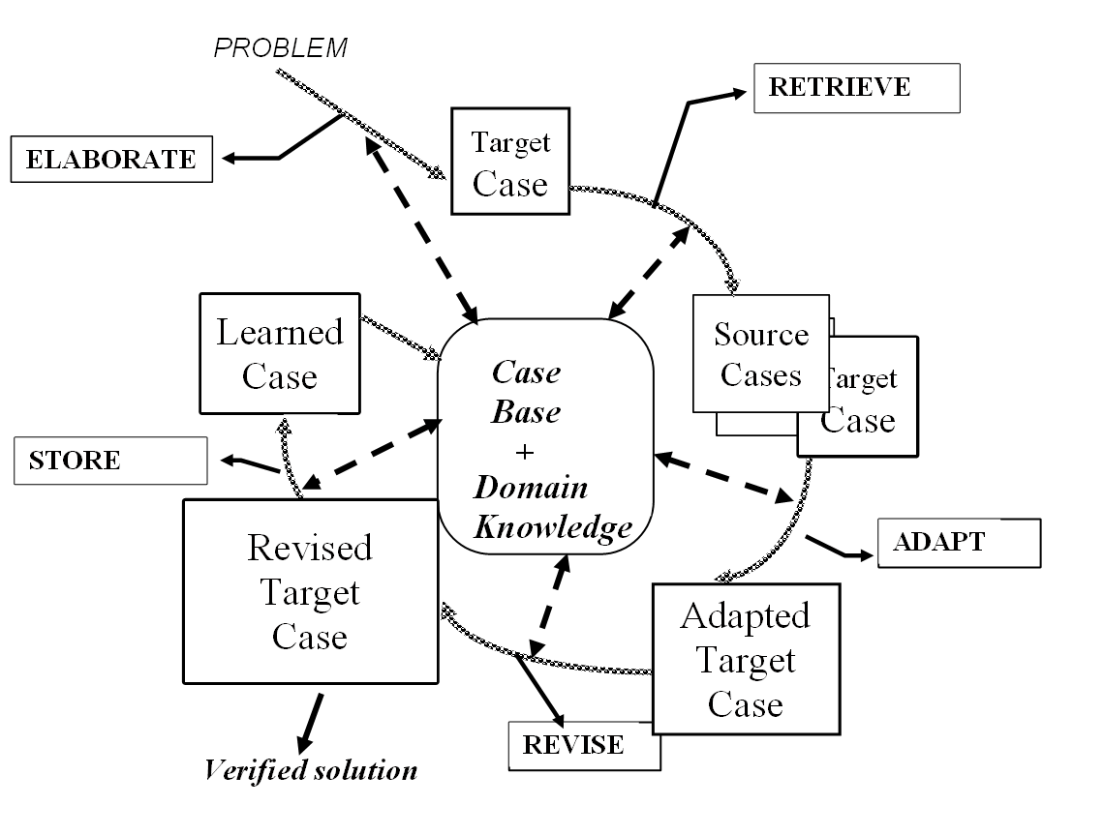
From CBR to TBR?
CBR

Slide 4
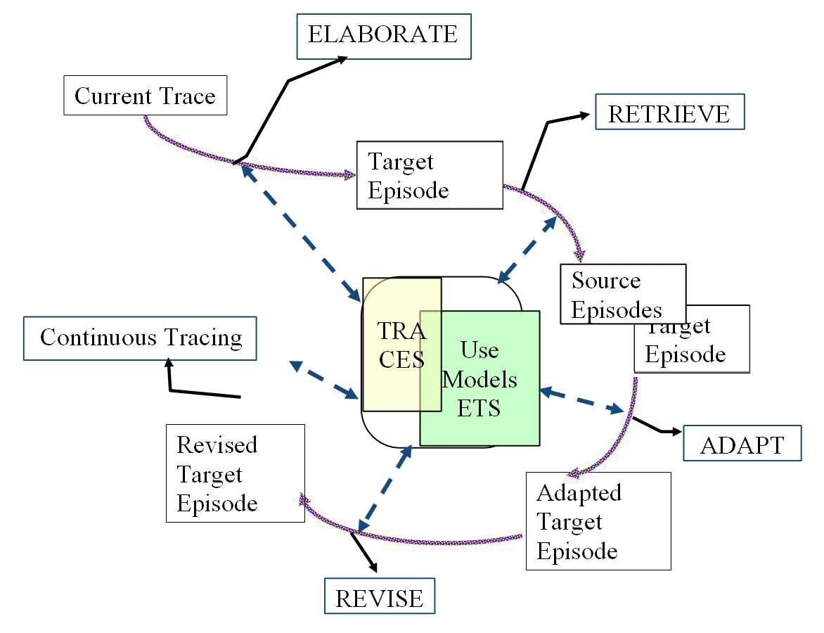
From CBR to TBR?
TBR

Slide 5
Traces? General definition
Trace: Set of elements which are inscribed in the environment during an activity.
  The traces are inscribed intentionally or not.
  These traces can be considered as containing indexes of activity by “experienced” observers.
Digital trace: Sequence of elements which are inscribed in the digital environment by itself on the base of the user activity (the user asks to inscribe these elements intentionally or not).
Elements = events, actions, annotations, interacted digital objects …
    possibly associated at observation time (relations are observed too).
    time ordered (and spatially located?)

Slide 6
Traces? Modeled traces.
Trace Model
  A trace model defines a vocabulary for describing traces:
    how time is represented (T),
    how observed elements are categorized (C),
    what relations may exist between observed elements (R),
    what attributes further describe each observed elements (A).
    The domain and range function constrain the kind of relations and attributes that an observed element of a given type may have. Partial orders ≤C and ≤R induce a type hierarchy for observed elements and relations. The last constraint guarantees the consistency of domain and range between a relation and its parents in the hierarchy.

Slide 7
Traces? Modeled traces
M-Trace
  An M-Trace represents, according to a trace model ( ),
    a given period of observation ( ),
    it contains a set of typed observed elements ( ),
    located in time ( ),
    possibly in relation with each other ( ),
    and described by attribute values ( ).
    each observed element o has exactly one direct type ( is a total function),
    the relation ≤_{C} induces a kind of type inheritance, so every type c ≥ λ_{C}(o) may be considered an indirect type of o,
    there may be no, one or several relation(s) between two observed elements,
    finally, attribute values are never mandatory.
  The M-Trace is consistent with its model if its temporal extension actually belongs to the model’s temporal domain, and if domain and range constraints on relations and attributes are all satisfied.

Slide 8
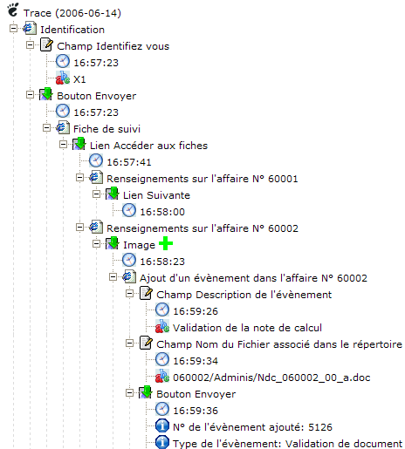
Traces? First illustration

Slide 9
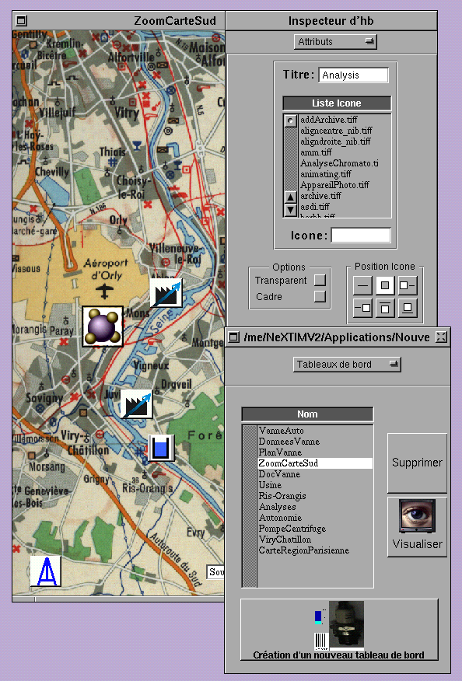
Trace Based System
DIGITAL ENVIRONMENT

Slide 10
Trace Based System
Digital envt
Interaction
elements
User given
elements
Audio, video
Multimedia annotations
Digital agent
Human agent
External
captures
DIGITAL ENVIRONMENT

Slide 11
Trace Based System
TRACE BASE
M_{TR}
TR
PRIMARY TRACE
Digital envt
Interaction
elements
User given
elements
Audio, video
Multimedia annotations
COLLECTING
ELEMENTS
DIGITAL ENVIRONMENT
Digital agent
Human agent
External
captures

Slide 12
Trace Based System
TRANSFORMED TRACE
M_{TR}
TR
TRACE BASE
Transformation
M_{TR}
TR
PRIMARY TRACE
Digital envt
Interaction
elements
User given
elements
Audio, video
Multimedia annotations
COLLECTING
ELEMENTS
DIGITAL ENVIRONMENT
Digital agent
Human agent
External
captures

Slide 13
Trace Based System
PRIMARY TRACE
Digital envt
Interaction
elements
User given
elements
Audio, video
Multimedia annotations
COLLECTING
ELEMENTS
DIGITAL ENVIRONMENT
Digital agent
Human agent
External
captures

Slide 14
Trace Based System
Standard
statistics
Standard
visualization
PRIMARY TRACE
Digital envt
Interaction
elements
User given
elements
Audio, video
Multimedia annotations
COLLECTING
ELEMENTS
DIGITAL ENVIRONMENT
Digital agent
Human agent
External
captures

Slide 15
Trace Based System
ALTER EGO
ASSISTANT
For experience
reusing and sharing
Requests
PRIMARY TRACE
Digital envt
Interaction
elements
User given
elements
Audio, video
Multimedia annotations
COLLECTING
ELEMENTS
DIGITAL ENVIRONMENT
Digital agent
Human agent
External
captures

Slide 16
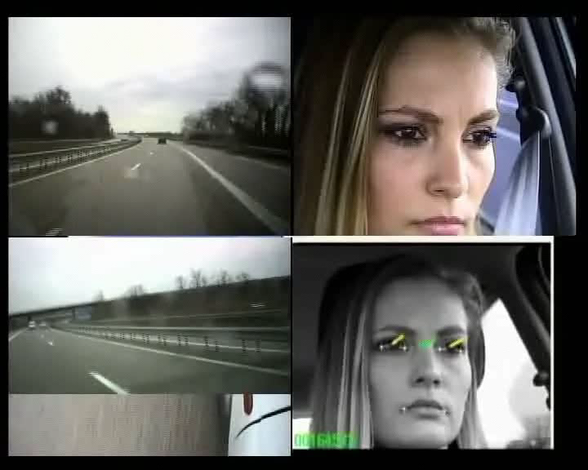

Trace based sysem: an exemple
Driver activity analysis: behavioral traces
ABSTRACT system
Olivier.georgeon@inrets.fr
Matthias.henning@phil.tu-chemnitz.de
Benoit.Mathern@ecl2006.ec-lyon.fr
Alain.Mille@liris.cnrs.fr
Thierry.bellet@inrets.fr

Slide 17
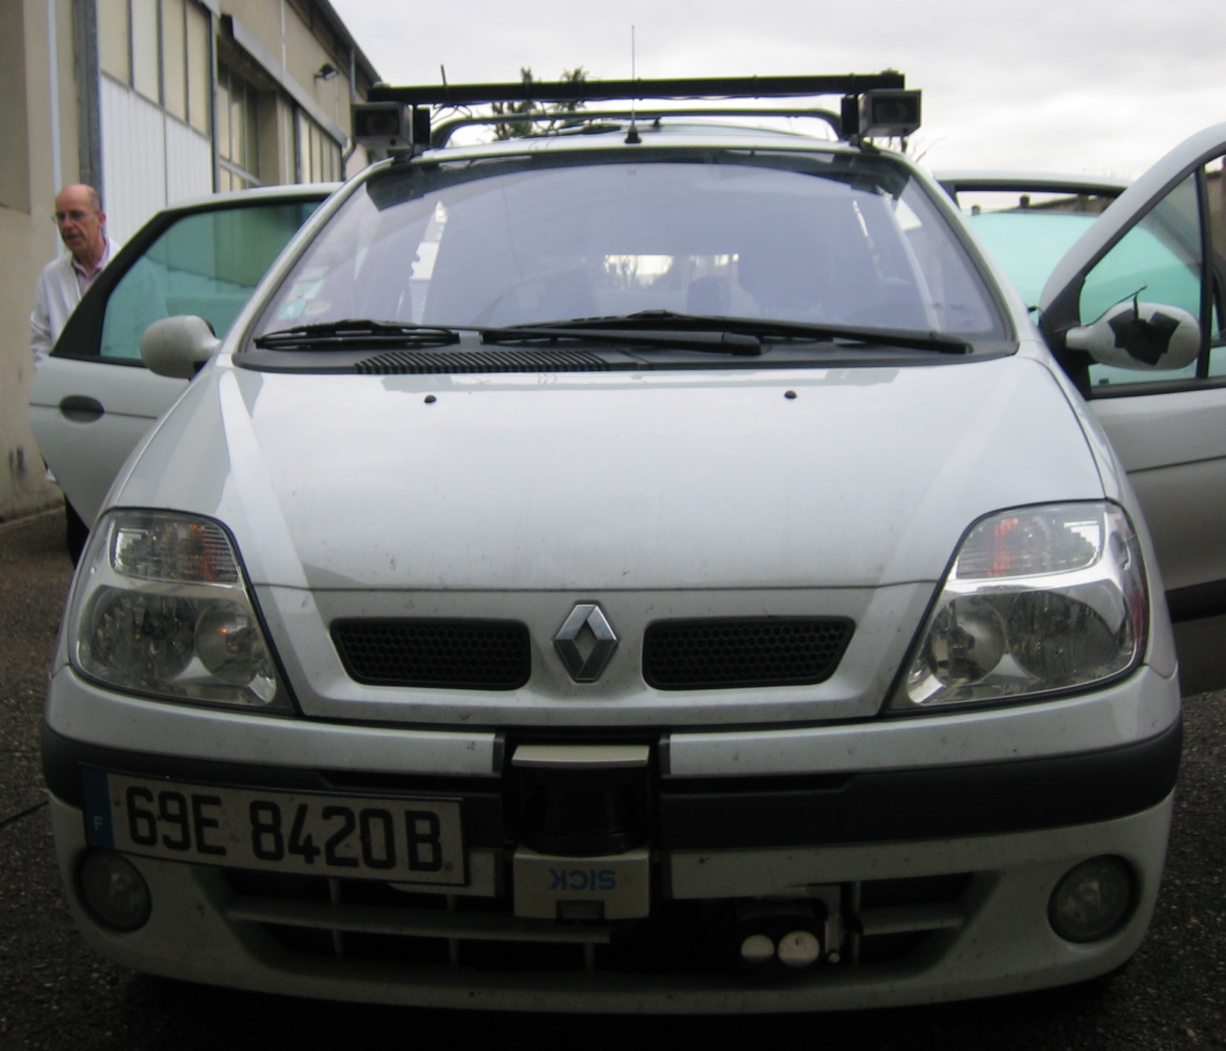
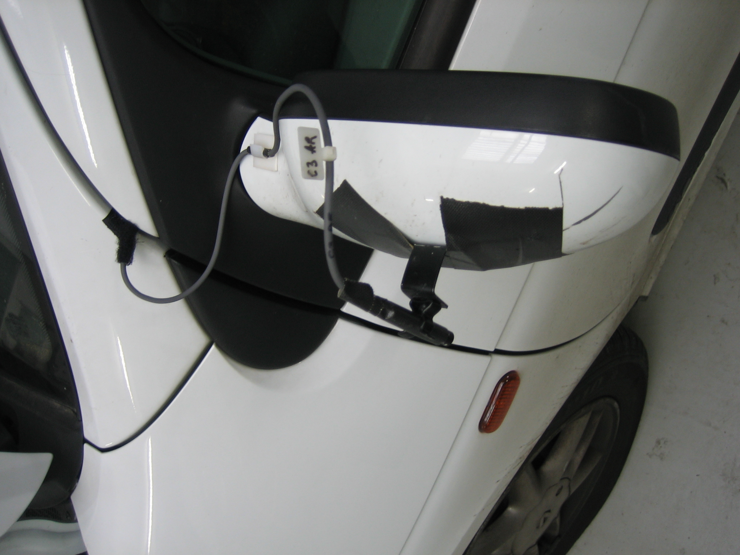
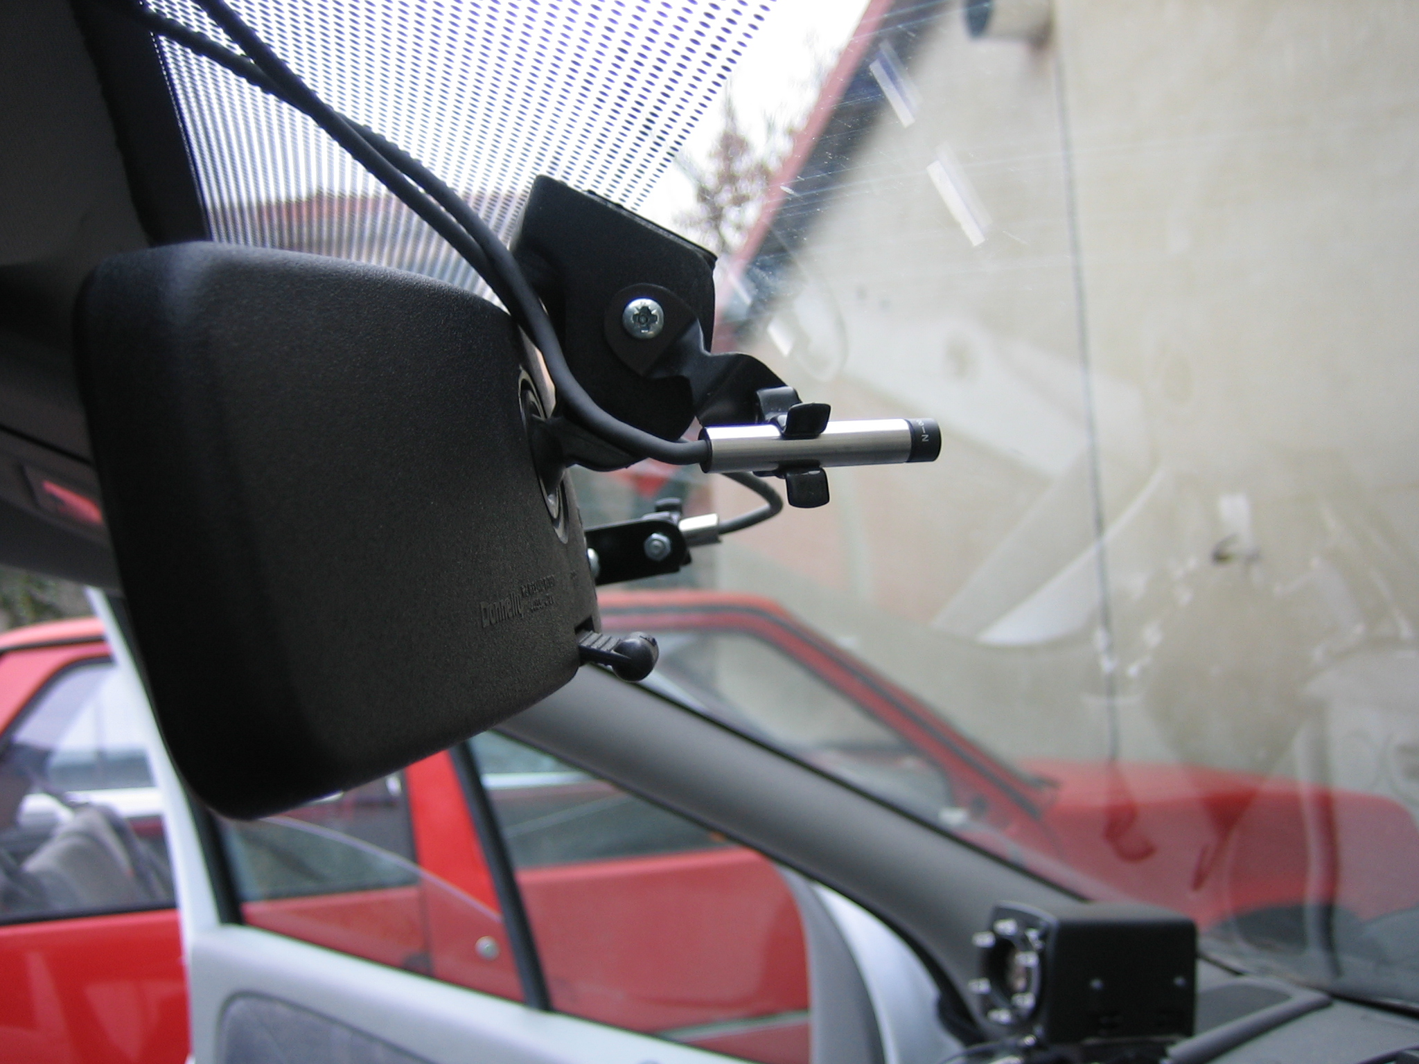
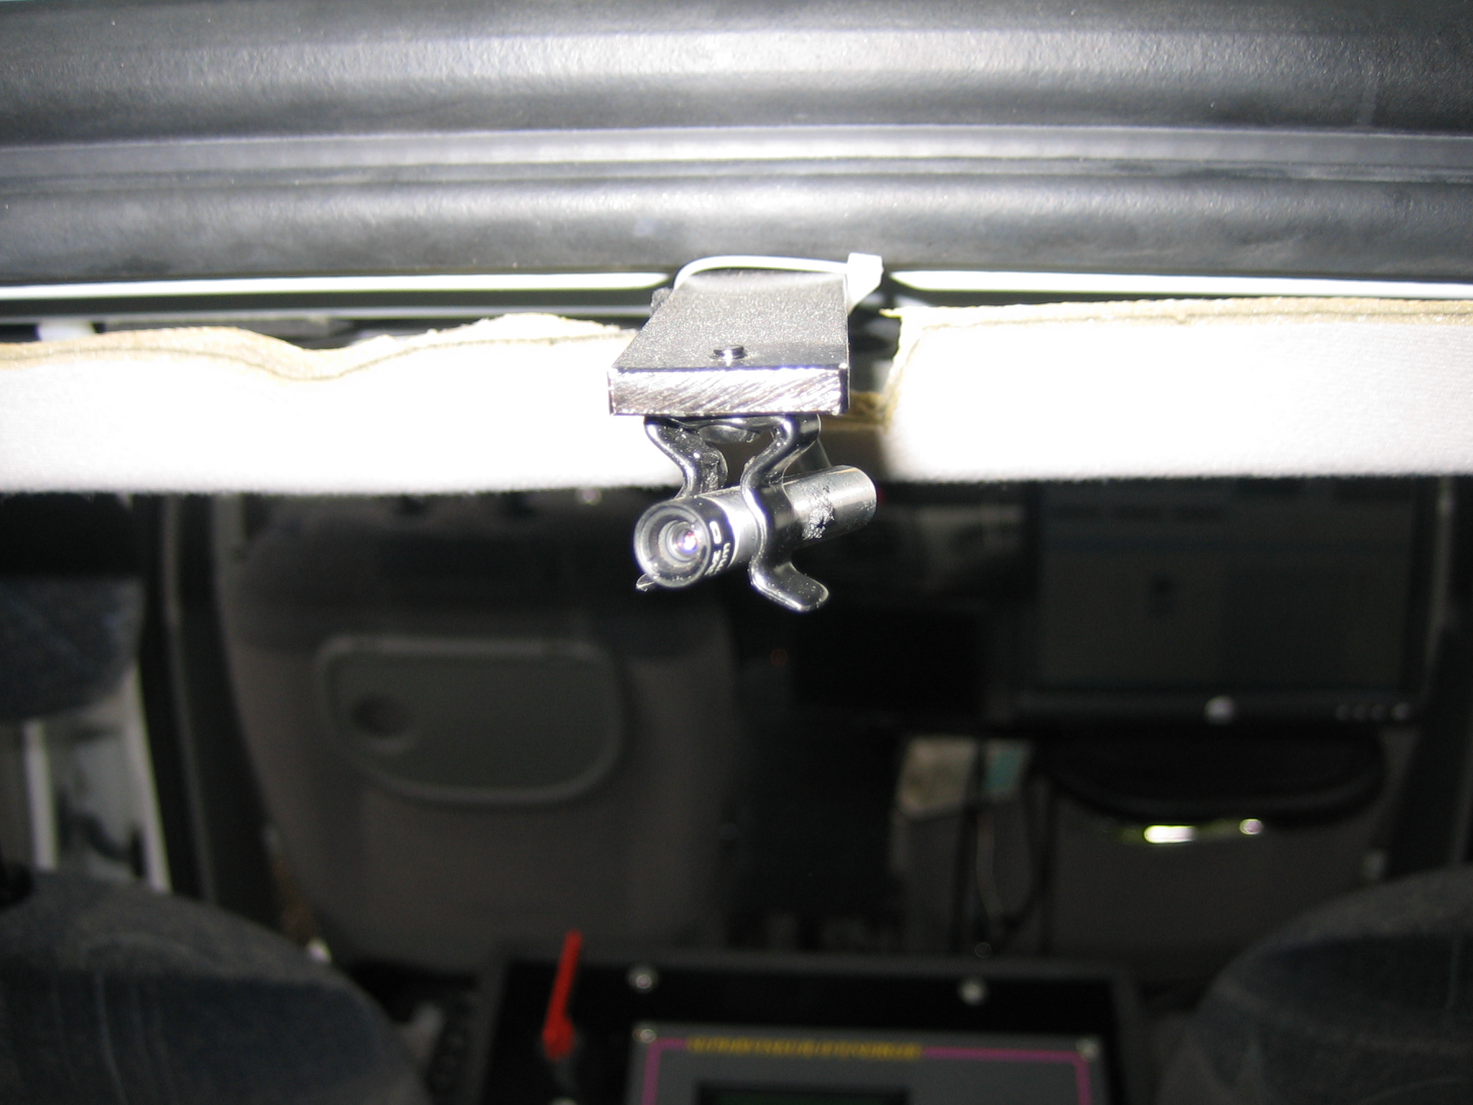
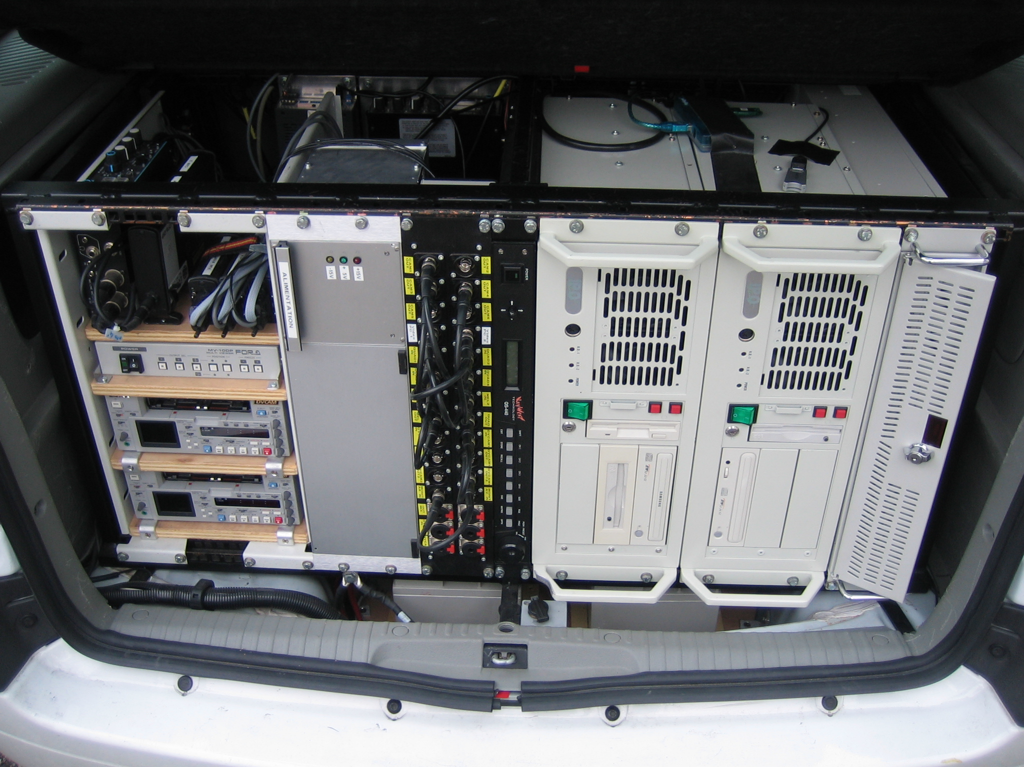
The car

Slide 18
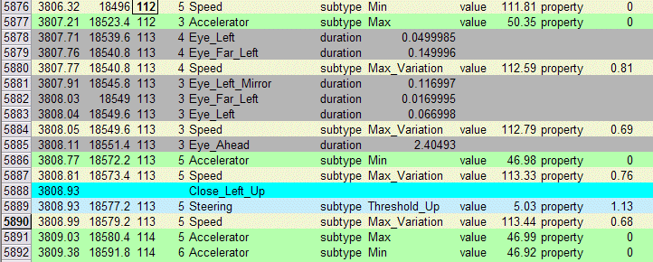


Primary trace
First transformation requests
  Eye_sequence_end: Eye_Ahead during more than 0.9s
  Short_Left_Mirror_Glance: Sequence < 0.8s AND including at least One Eye_Left_Mirror

Slide 19
The SBT interface (for the analyst)

Slide 20
New signatures -> new trace model

Slide 21
Analysis applications
Enhancing comfort and security for the driver
Enhancing benefits of « advanced driver assistance systems (ADAS) and « in-vehicle information systems (IVIS) which should react:
  According to the traffic
  According to the driver « intentions »
Example: triggering an alert for the driver for a « lane passing » if it is assumed that it is not a voluntary act.

Slide 22
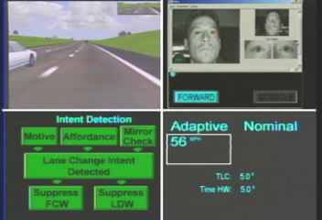
Driving learning on simulator

Slide 23
Reusing experience?
Traces as experience containers
How to reuse « episodes » of activity as « sources » for new target episodes.
« Dynamic » CBR process

Slide 24

Experience reusing assistance
Illustration
Current Interaction
Trace

Slide 25
Illustration, tracing
Trace Base

Slide 26
Illustration, asking for help
Episode Signature
Help!
Trace Base

Slide 27
Illustration, target elaboration
Constraints
On
Target solution
Episode Signature
Target
problem
Trace Base

Slide 28
Illustration / Episodes Retrieval

Slide 29
Illustration / Target Adaptation
Best source episode
The proposed color for the triangle is orange

Slide 30
TBR issues: co-constructing models
Trace models are personalized in order to fit the user “point of view” (trace transformations). The assistant can help by mining promising patterns for building new abstractions of a particular trace.
Retrieval needs to build a signature of episode: this signature can be built with the assistant which can mine the traces to find promising patterns.
Repairing adaptation allows to precise a signature by a better contextualization of the target (adding a new constraint coming from previous elements in the trace for example).
Repairing adaption allows to learn any knowledge useful for further experience reusing. (thanks to Amélie!)

Slide 31
Generalized TBR architecture
Alter-ego assistant
Services
TBS

Slide 32
Generalized TBR architecture

Slide 33
Applications
Technology Enhanced Learning
  Perlea (Leaner Profiles Management)
  Ambre (Assisting Learning of Methods by Experience Reusing)
  Geonote (Preparing and sharing knowledge about geological models)
  Ithaca (Co-constructing and sharing knowledge on French culture and language) ANR project, E-Lycee company (USA!)
  Moodle-traces (a specific Moodle TBS for indicators modeling and indicators computing in context)
  Dynamic designing of training periods for operators (EDF)
Knowledge management, knowledge engineering
  Procogec (Helping co-construction of collaborative groups) ANR Project, Knowings, GDF, Antecim
  Abstract: (Analysis of behavior and situation for mental representation assessement and cognitive modelling) European project, INRETS
Assistants
  Reusing and sharing know how (Dassault)
  Sharing practices between very different people (people with very different interaction modalities) Orange Lab

Slide 34
Articulation with the next talk…
Towards a general adaptation process for TBR?
Thank you Jean!

