Slide 1
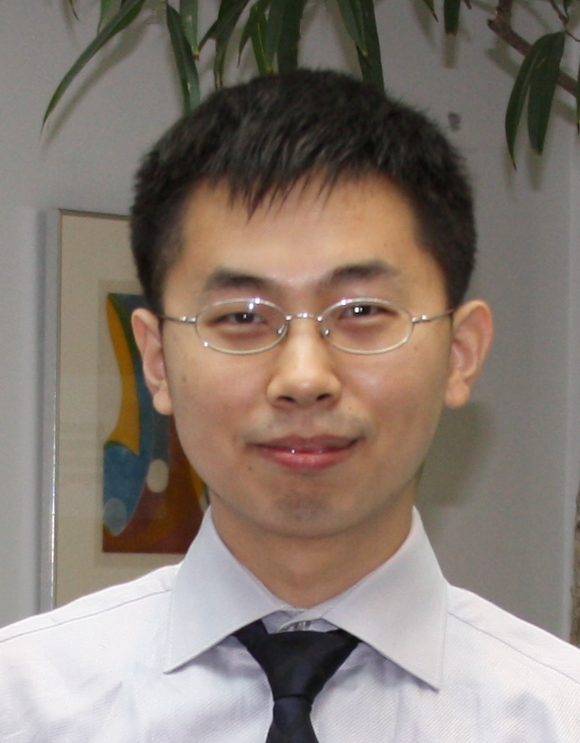
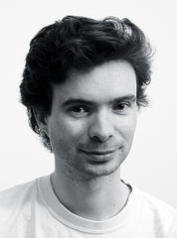
Interactive Intrinsic Video Editing
Nicolas Bonneel ^{1,2}
Kalyan
Sunkavalli ³
James Tompkin ²
Deqing Sun ²
Sylvain
Paris ³
Hanspeter Pfister ²
1
1
2
3

Slide 2
Our goal: enable illumination-aware
video editing

Slide 3
Input sequence

Slide 4
Naïve editing (not illumination aware)

Slide 5
Our illumination-aware result

Slide 6
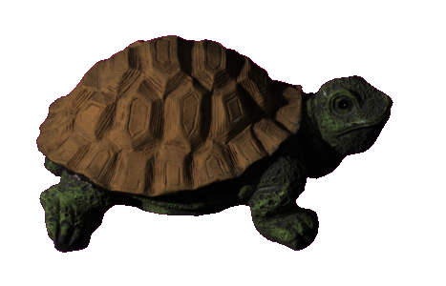
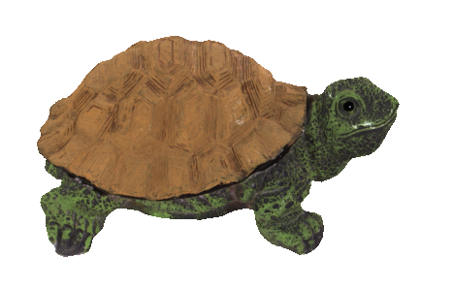
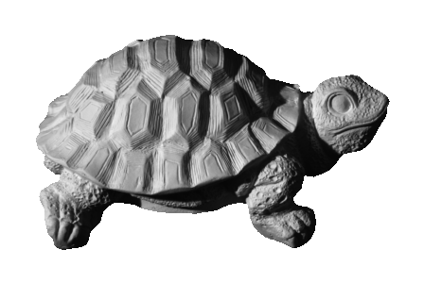
Intrinsic decomposition
Under diffuse assumption:
Image = Reflectance (R) x Shading (S)
Intrinsic decomposition: recovering R and S

Slide 7
Intrinsic decomposition
Severely ill-posed!
Image = Reflectance (R) x Shading (S)
x
x
?
x
…
…
Notes:
Explain why it is hard…

Slide 8
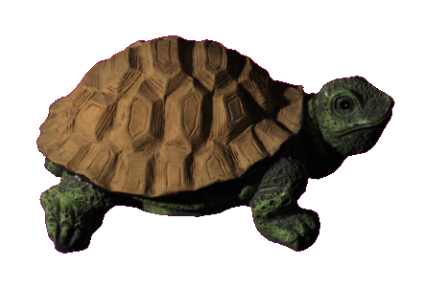
Goals
1. Edit reflectance and shading independently
=
*
[Images courtesy Grosse et al. 2009]

Slide 9
Goals
1. Edit reflectance and shading independently
2. Time coherent editing
Naïve application of static image method [Bell et al. 2014] frame by frame

Slide 10
Goals
1. Edit reflectance and shading independently
2. Time coherent editing
3. Fast enough for user interaction
Reflectance
2x speed

Slide 11
Intrinsic Images
Ill-posed problem → Priors
Smooth shading [Land et al. 1971]
Monochromatic lighting [most of existing techniques]
Few reflectance colors [Garces et al. 2012, Ye et al. 2014]
Locally low shading dimensionality [Bousseau et al. 2009]
Planckian lighting [Finlayson et al. 2006]
…

Slide 12
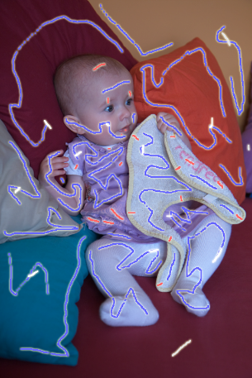
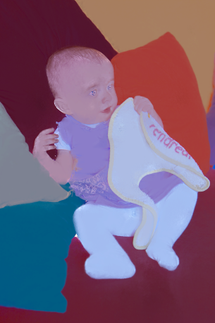
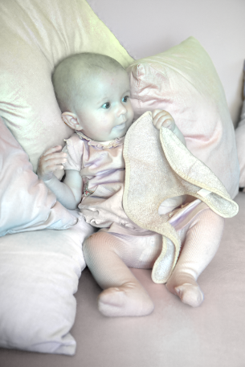
Intrinsic Images
[Bousseau et al. 2009]
Input with scribbles
Reflectance
Shading

Slide 13
Intrinsic Videos
Ye et al. introduced intrinsic videos [2014]
Good automatic results…
…but no/slow interaction

Slide 14
Color editing – Ye et al. 2014
1 minute per frame
Notes:
Identify a problem with Ye et al. here – that we need very fast artist feedback, in an interactive system – to stop these errors happening and reduce the hours of wait between results.
In the next few slides, describe how to overcome it

Slide 15
Contributions
1. Time-coherent intrinsic video decomposition
Reflectance
Shading

Slide 16
Contributions
1. Time-coherent intrinsic video decomposition
2. Fast algorithm based on look-up tables
second per frame instead of minute per frame

Slide 17
Contributions
1. Time-coherent intrinsic video decomposition
2. Fast algorithm based on look-up tables
seconds instead of minutes
3. Useful for high-quality video editing
Illumination-aware retexturing
Notes:
We also then use this system to introduce new video editing applications, such as the house we saw at the beginning, and illumination-aware video compositing.

Slide 18
Our method

Slide 19
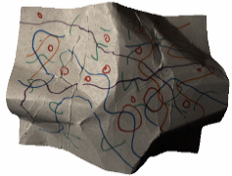
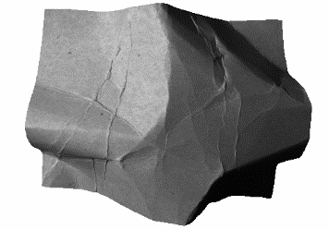
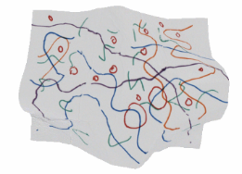
Data fitting term
Input image (I)
Illumination (S)
Reflectance (R)
$$=$$
$$×$$
$$I=S×R$$
$$\log{I}=\log{S}+\log{R}$$
$∇\log{I}=∇\log{S}+∇\log{R}$
$$i$$
$$=$$
$$s$$
$$+$$
$$r$$
Objective function:
$${E= \left\|i −(s+r)\right\|}^{2}$$

Slide 20
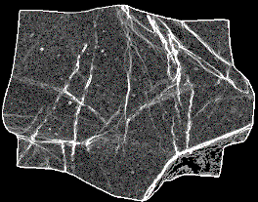
Smooth shading term
Input image (I)
Illumination (S)
Reflectance (R)
$$=$$
$$×$$
Illumination gradients
are not sparse
Objective function:
$${E= \left\|i −(s+r)\right\|}^{2}+{{ λ}_{s}\left\|s\right\|}^{2}$$

Slide 21
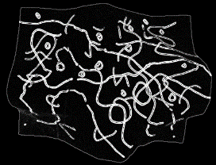
Sparse reflectance term
Input image (I)
Illumination (S)
Reflectance (R)
$$=$$
$$×$$
Reflectance gradients
are sparse
Objective function:
$${E= \left\|i −(s+r)\right\|}^{2}+{{ λ}_{s}\left\|s\right\|}^{2}+{{ λ}_{r}\left\|r\right\|}^{p}$$

Slide 22
L²-L^{p} decomposition
Solution from iterative procedure (see paper)
$$r_{k+1}=\frac{2λ_{s}i}{2λ_{s} + λ_{r}\left(1 + λ_{s}\right)p{\left|r_{k}\right|}^{p−2} }$$
Even better, tabulate result in lookup tables depending on input pixel value and parameters
Extends Retinex [Land 1971]
$$r_{0}=i$$
Notes:
Here we need to stress in the voiceover what makes it fast. How does this relate to our goals and contributions?

Slide 23
Solver overview
Pre-processing
Precompute lookup tables
At runtime
$∇\log{R}=\text{Lookup}(∇\log{I}, λ_{R}, λ_{S}, p)$
$∇\log{S}=∇\log{I} − ∇\log{R}$
Solve Poisson equation to obtain $log S$
Exponentiate

Slide 24
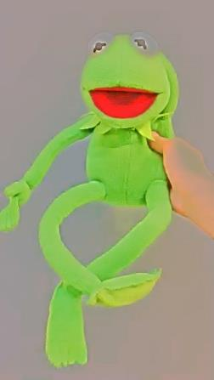
Additional priors
Few different reflectances [Garces et al. 2012…]
Non-local constraints in Poisson solver
Original
Original – non-local
similarities found
Reflectance
with transfer function
With non-local constraints

Slide 25
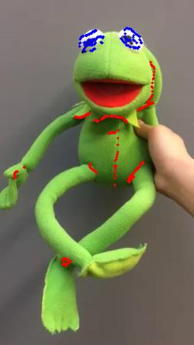
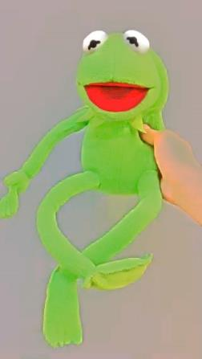
Additional priors
User scribbles [Bousseau et al. 2009]
Original – user
scribbles added
Original
Reflectance
with non-local constraints
With user scribbles

Slide 26
Temporal consistency
Adds energy term to Poisson solver
$${\left\|R_{t}−{\text{warp}(R}_{t−1})\right\|}^{2}$$
Causal propagation
Easy to solve frame by frame [Paris 2008…]
Intuitive: does not affect past frames [Bai et al. 2009…]
Reflectance at previous frame
warped with optical flow
Reflectance at current frame

Slide 27
Applications and Results

Slide 28
Results
State-of-the-art static image method applied frame by frame

Slide 29
Results
Our result
0.5 s per frame
User interaction: 6 min
[Ye et al., SIGGRAPH 2014] 1 min per frame
Interaction on first frame
Notes:
+ADD ZOOM

Slide 30
Limitations
Monochromatic illumination
Sometimes: too smooth illumination layer
User interaction required for best results

Slide 31
Applications and Results

Slide 32
Applications and Results
Original
Retextured

Slide 33
Applications and Results

Slide 34
Applications and Results
Original
Recoloring

Slide 35
Applications and Results

Slide 36
Applications and Results
Original
Softening shadows

Slide 37
Applications and Results

Slide 38
Applications and Results
Naïve compositing
Our compositing

Slide 39
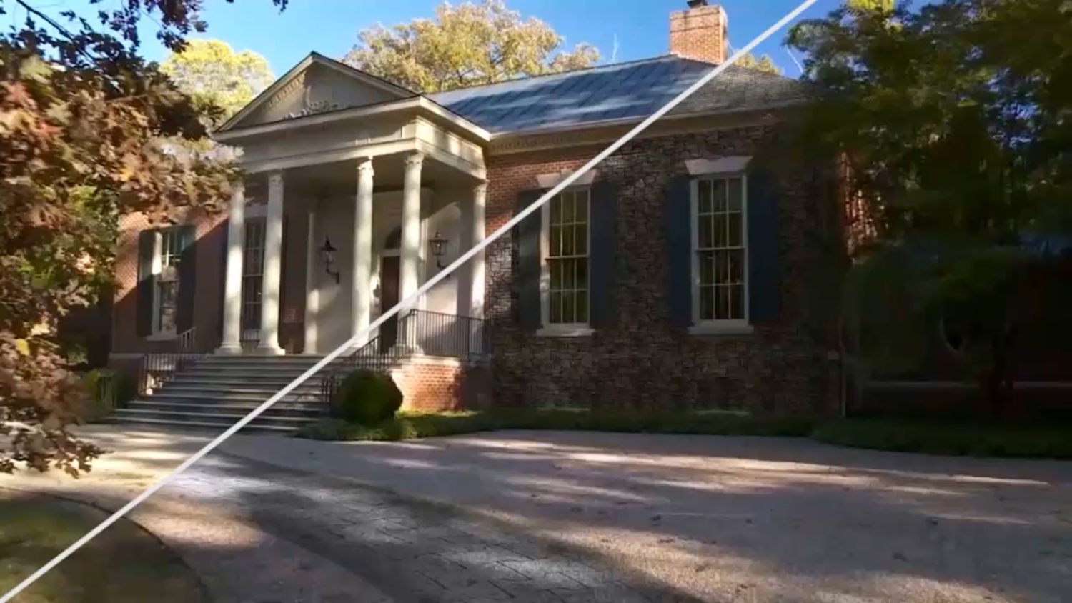
Conclusion
Fast and accurate intrinsic video decomposition
User interaction
High-quality video editing
L²-L^{p} formulation
Fast solver (0.5 s/frame)
Simple lookup tables
Subsumes Retinex
Data are available
http://liris.cnrs.fr/~nbonneel/intrinsic.htm

Slide 40
Acknowledgements
Diego Guttierez and Ghenzi Ye for their help with the comparison.
We thank the SIGGRAPH reviewers for their feedback. This work was partially supported by NSF grants CGV-1111415, IIS-1110955, OIA-1125087 and the Région Rhône-Alpes.
Authors of the videos (details in paper).

