Slide 1
Semi-discrete optimal transport

Slide 2
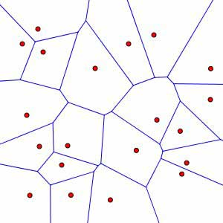
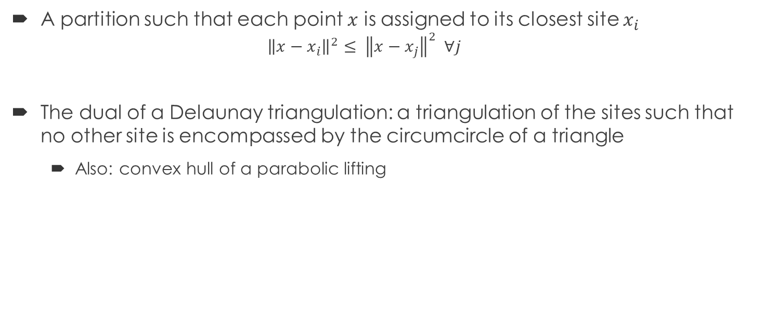
Voronoi diagram
A partition such that each point $x$ is assigned to its closest site $x_{i}$
$${\left\|x−x_{i}\right\|}^{2}≤ {\left\|x−x_{j}\right\|}^{2} ∀j$$
The dual of a Delaunay triangulation: a triangulation of the sites such that no other site is encompassed by the circumcircle of a triangle
Also: convex hull of a parabolic lifting

Slide 3
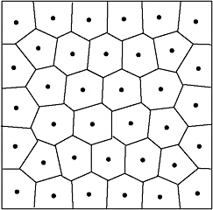
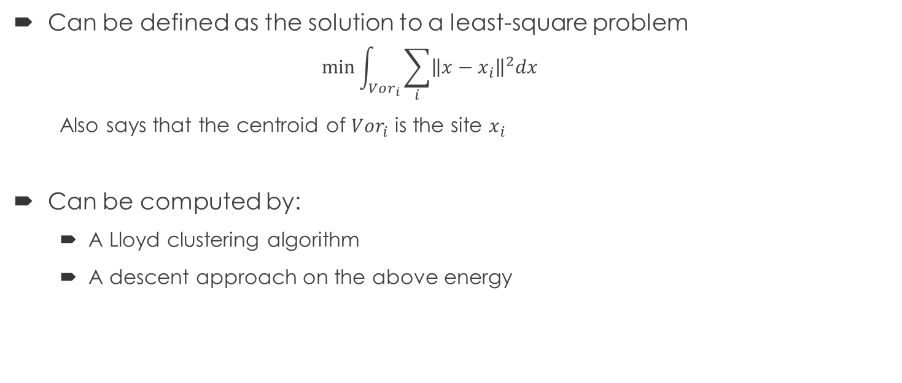
Centroidal Voronoi Diagram
Can be defined as the solution to a least-square problem
$$\min{\int_{Vor_{i}}{\sum_{i}{{\left\|x−x_{i}\right\|}^{2}dx}}}$$
Also says that the centroid of $Vor_{i}$ is the site $x_{i}$
Can be computed by:
A Lloyd clustering algorithm
A descent approach on the above energy

Slide 4
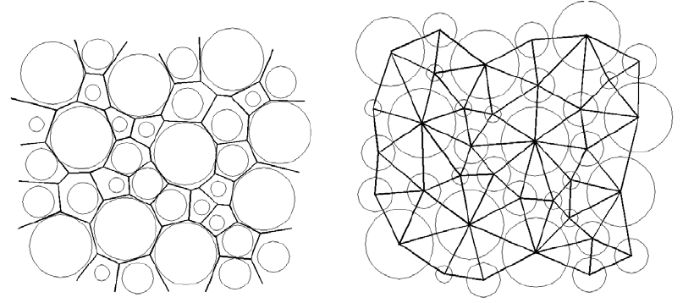
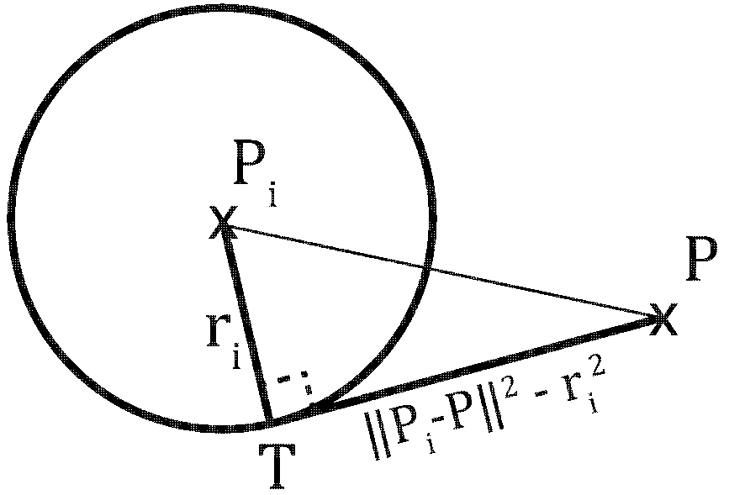

Power Diagram (Laguerre diagram)
A partition s.t. each point $x$ is assigned to its closest site $x_{i}$ with weight $r_{i}$
$${\left\|x−x_{i}\right\|}^{2}−w_{i}≤ {\left\|x−x_{j}\right\|}^{2} −w_{j} ∀j$$
Replaces distance to closest site with distance to closest tangential point to a circle of radius $r_{i}=\sqrt{w_{i}}$
Any partition into convex polyhedral cells is a power diagram of some sites

Slide 5
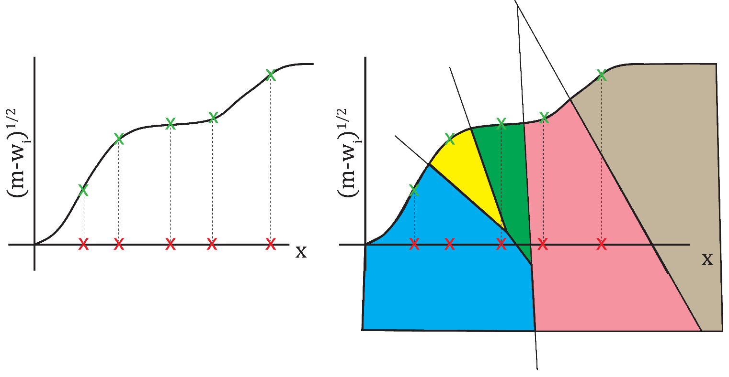

Power Diagram (Laguerre diagram)
Can be computed by lifting a Voronoi diagram
Consider site coordinates $x_{i}^{′}=\left( x_{i} ; \sqrt{m−w_{i}}\right)$ for large constant m ; $x^{′}=\left(x ;0\right)$
Then ${\left\|x′−x_{i}^{′}\right\|}^{2}≤ {\left\|x′−x_{j}^{′}\right\|}^{2} ∀j$
Some cells can be empty (e.g., yellow and green) and some sites can be outside of their cell (e.g., gray)

Slide 6
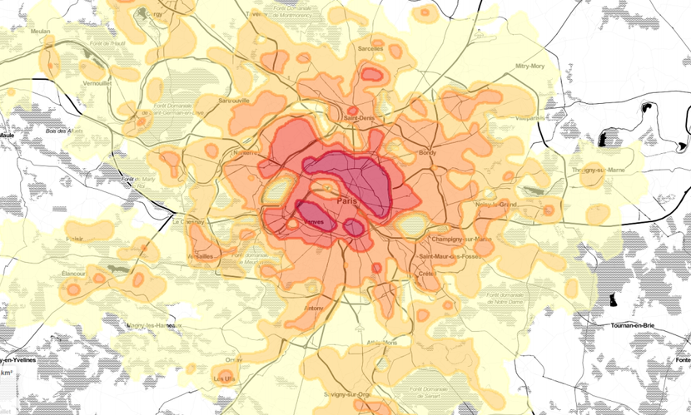

Semi-discrete Optimal Transport
Population density $f$

Slide 7
Semi-discrete Optimal Transport
x
x
x
x
x
x
Set of bakeries, factories, …?

Slide 8
Semi-discrete Optimal Transport
x
x
x
x
x
x
No constraint on production: population go to their nearest bakery/factory/… regardless of population density

Slide 9
Semi-discrete Optimal Transport
x
x
x
x
x
x
Limited production: population go to the nearest bakery/factory with sufficient production!

Slide 10
Semi-discrete Optimal Transport
(needs for)
population here
x
=
x
x
x
quantity produced here
x
x
Limited production: population go to the nearest bakery/factory with sufficient production!

Slide 11
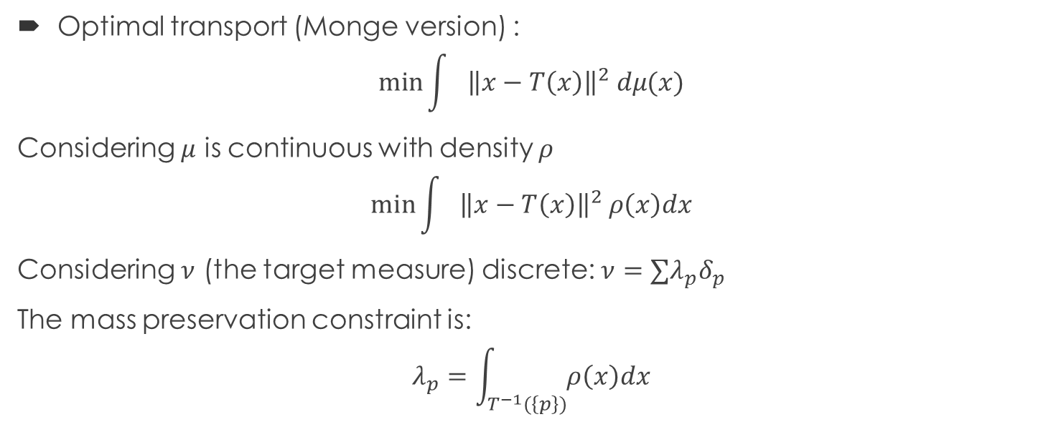
Back to optimal transport
Optimal transport (Monge version) :
$$\min{\int{{\left\|x−T\left(x\right)\right\|}^{2} dμ(x)}}$$
Considering $μ$ is continuous with density $ρ$
$$\min{\int{{\left\|x−T\left(x\right)\right\|}^{2} ρ\left(x\right)dx}}$$
Considering $ν$ (the target measure) discrete: $ν=∑λ_{p}δ_{p}$
The mass preservation constraint is:
$$λ_{p}=\int_{T^{−1}(\left\{p\right\})}{ρ\left(x\right)dx}$$
A Multiscale Approach to Optimal Transport [Mérigot 2011] Minkowski-Type Theorems and Least-Squares Clustering [Aurenhammer et al. 98]

Slide 12
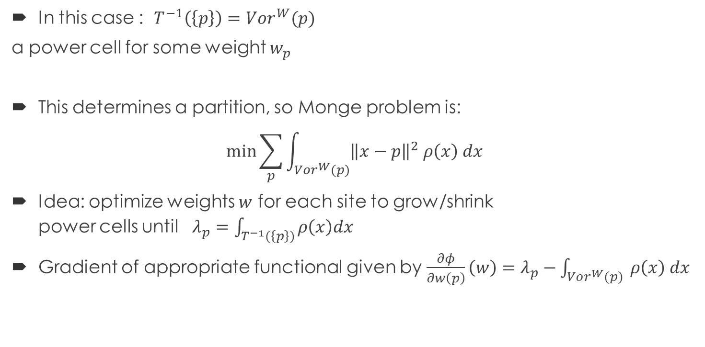
Back to optimal transport
In this case : $T^{−1}\left(\left\{p\right\}\right)=Vor^{W}(p)$
a power cell for some weight $w_{p}$
This determines a partition, so Monge problem is:
$$\min{\sum_{p}{\int_{Vor^{W}(p)}{{\left\|x−p\right\|}^{2} ρ\left(x\right) dx}}}$$
Idea: optimize weights $w$ for each site to grow/shrink power cells until $λ_{p}=\int_{T^{−1}(\left\{p\right\})}{ρ\left(x\right)dx}$
Gradient of appropriate functional given by $\frac{∂φ}{∂w\left(p\right)}\left(w\right)=λ_{p}−\int_{Vor^{W}(p)}{ ρ\left(x\right) dx}$
x
p

Slide 13
Back to optimal transport
A Multiscale Approach to Optimal Transport [Mérigot 2011]
A Numerical Algorithm for L2 Semi-discrete Optimal Transport in 3D [Lévy 2015]

Slide 14

Application
Also optimizes for the locations $p$
Blue Noise through Optimal Transport [de Goes et al. 2012]

Slide 15
Application to fluid simulation

Slide 16
Fluids with Optimal Transport
Lagrangian scheme
Add forces as usual (gravity, viscosity, surface tension…)
Recover incompressibility throught OT [Gallouët & Mérigot 2016]
Computes OT from particles to uniform density
Add force from particle towards power cell centroid
Enforces particles to spread uniformly => incompressibility

Slide 17
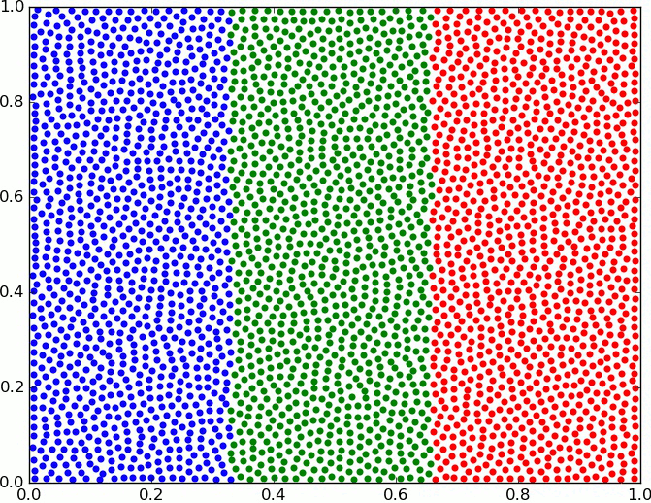


Fluids with Optimal Transport
Algorithm for 1 time step, at time step t : Explicit Euler
W = OT(Particles, Uniform Density)
For each particle:
$F_{spring}^{i}=\frac{1}{ε^{2}}\left(Centroid(Laguerre_{i})−X_{i}^{t}\right)$
$F^{i}=F_{spring}^{i}+m_{i}\vec{g}$
$v_{i}^{t+1}=v_{i}^{n}+\frac{dt}{m_{i}}F^{t}$
$X_{i}^{t+1}=X_{i}+dt v_{i}^{t+1}$
Bounce particles back into the domain
My implem: $ε=0.004$, dt = 0.002 and $m_{i}=200$.
[Gallouët & Mérigot 2016]

Slide 18
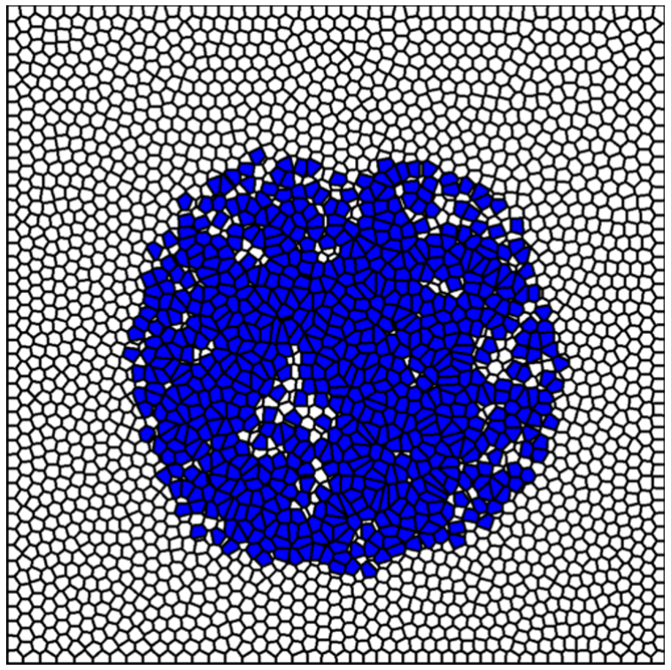
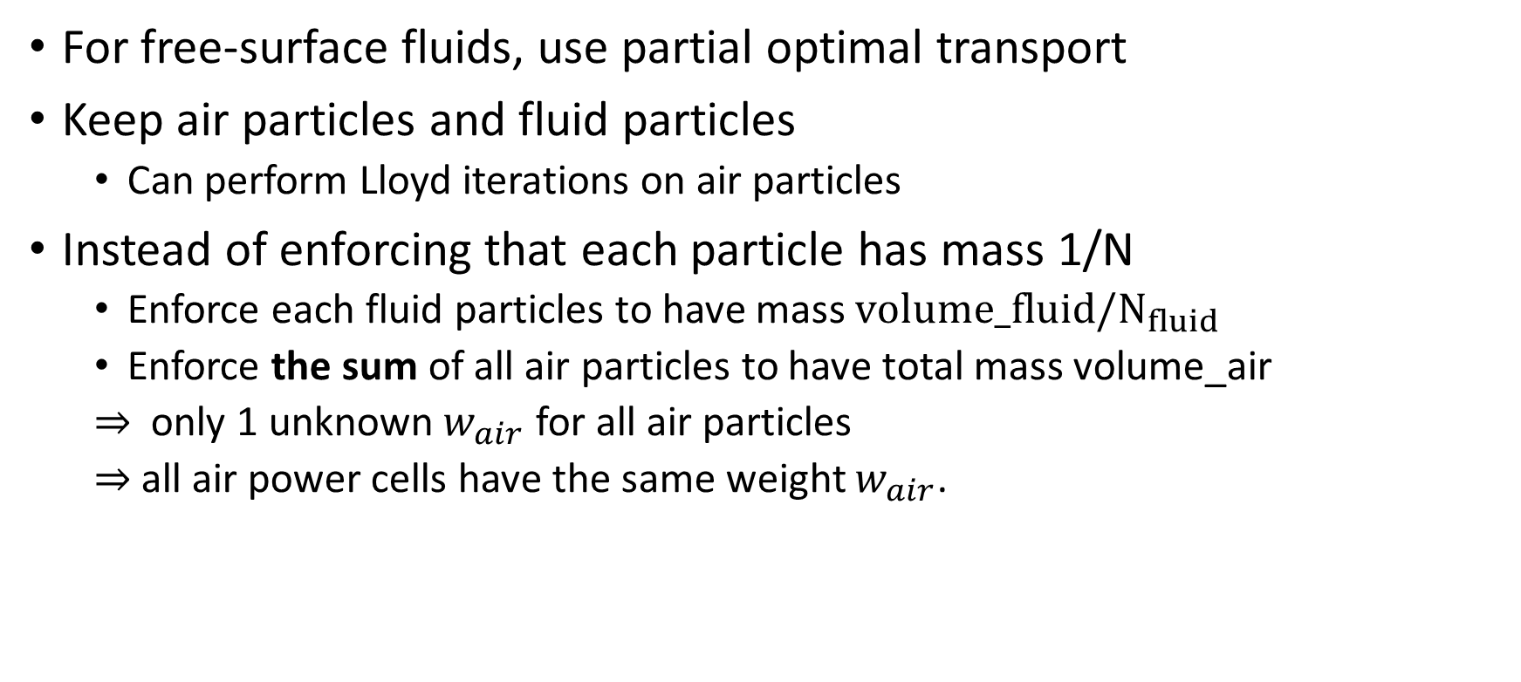
Fluids with Optimal Transport
For free-surface fluids, use partial optimal transport
Keep air particles and fluid particles
Can perform Lloyd iterations on air particles
Instead of enforcing that each particle has mass 1/N
Enforce each fluid particles to have mass $volume_fluid/N_{fluid}$
Enforce the sum of all air particles to have total mass volume_air
$⇒$ only 1 unknown $w_{air}$ for all air particles
$⇒$all air power cells have the same weight $w_{air}$.
“Partial Optimal Transport for a Constant-Volume Lagrangian Mesh with Free Boundaries” [Levy 2022]

Slide 19
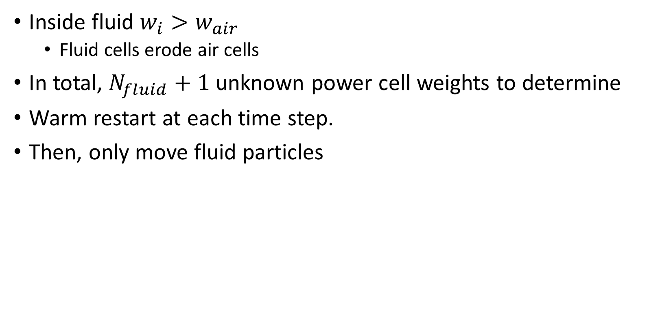
Fluids with Optimal Transport
Inside fluid $w_{i}>w_{air}$
Fluid cells erode air cells
In total, $N_{fluid}+1$ unknown power cell weights to determine
Warm restart at each time step.
Then, only move fluid particles

Slide 20
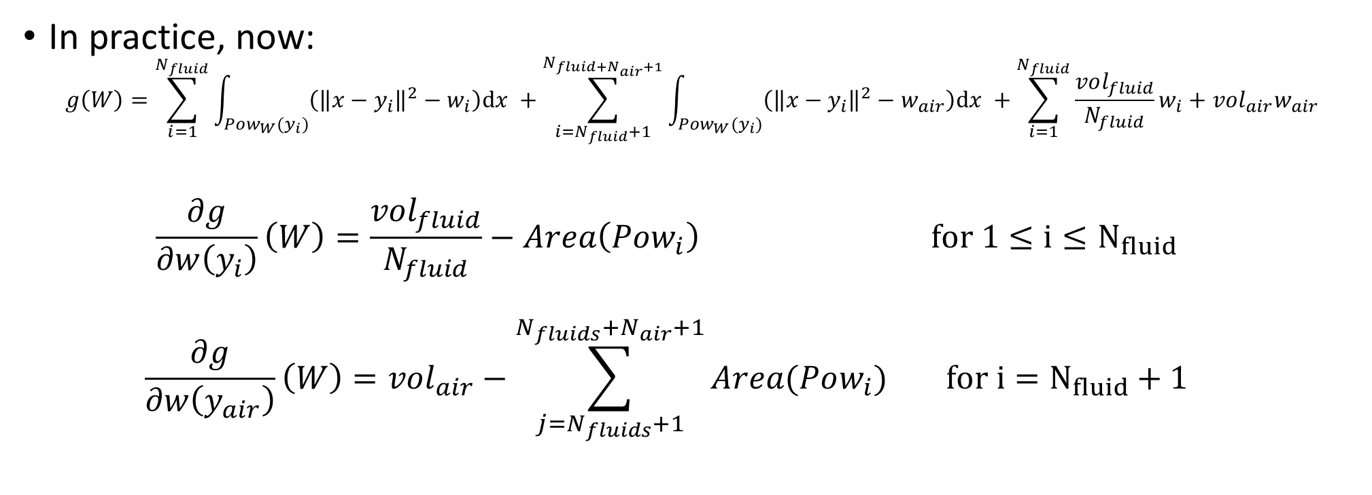
Fluids with Optimal Transport
In practice, now:
$$g\left(W\right)=\sum_{i=1}^{N_{fluid}}{\int_{Pow_{W}(y_{i})}{\left({\left\|x−y_{i}\right\|}^{2}−w_{i}\right)\text{d}x }}+\sum_{i=N_{fluid}+1}^{N_{fluid+N_{air}+1}}{\int_{Pow_{W}(y_{i})}{\left({\left\|x−y_{i}\right\|}^{2}−w_{air}\right)\text{d}x }}+\sum_{i=1}^{N_{fluid}}{\frac{vol_{fluid}}{N_{fluid}}w_{i}}+vol_{air}w_{air}$$
$$\frac{∂g}{∂w\left(y_{i}\right)}\left(W\right)=\frac{vol_{fluid}}{N_{fluid}}−Area\left(Pow_{i}\right) for 1≤i≤N_{fluid}$$
$$\frac{∂g}{∂w\left(y_{air}\right)}\left(W\right)=vol_{air}−\sum_{j=N_{fluids}+1}^{N_{fluids}+N_{air}+1}{Area(Pow_{i})} for i=N_{fluid}+1$$

Slide 21
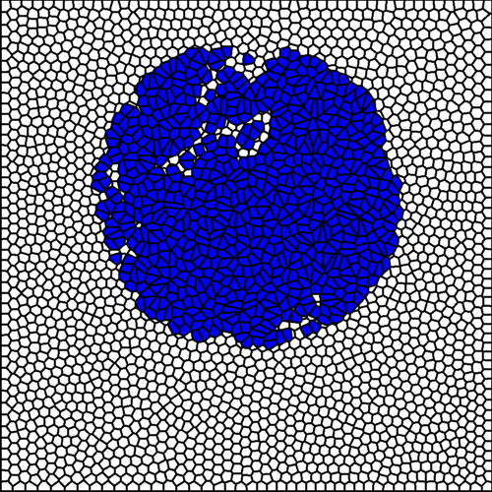
Fluids with Optimal Transport
$N_{fluid}=700, N_{air}=2500$, 1 sec/frame at beginning, 30 sec/frame at the end, with Nanoflann

Slide 22
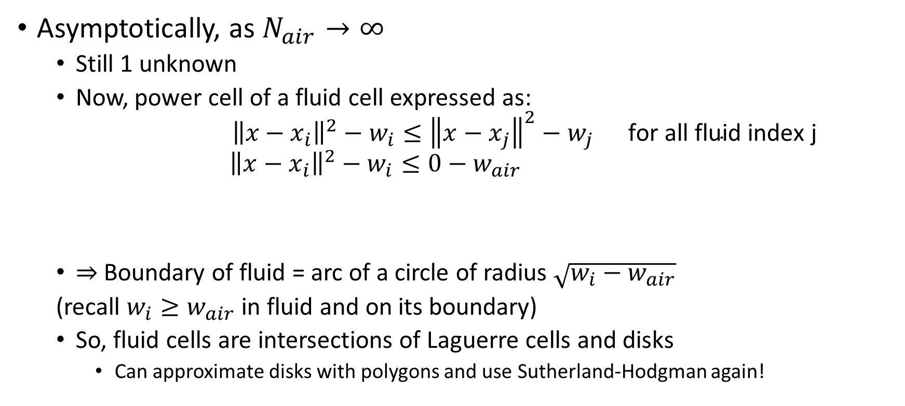
Fluids with Optimal Transport
Asymptotically, as $N_{air}→∞$
Still 1 unknown
Now, power cell of a fluid cell expressed as:
$${\left\|x−x_{i}\right\|}^{2}−w_{i}≤{\left\|x−x_{j}\right\|}^{2}−w_{j} \text{for} \text{all} \text{fluid} \text{index} \text{j}$$
$${\left\|x−x_{i}\right\|}^{2}−w_{i}≤0−w_{air}$$
$⇒$Boundary of fluid = arc of a circle of radius $\sqrt{w_{i}−w_{air}}$
(recall $w_{i}≥w_{air}$ in fluid and on its boundary)
So, fluid cells are intersections of Laguerre cells and disks
Can approximate disks with polygons and use Sutherland-Hodgman again!
There are air “particles” everywhere : min squared distance = 0

Slide 23
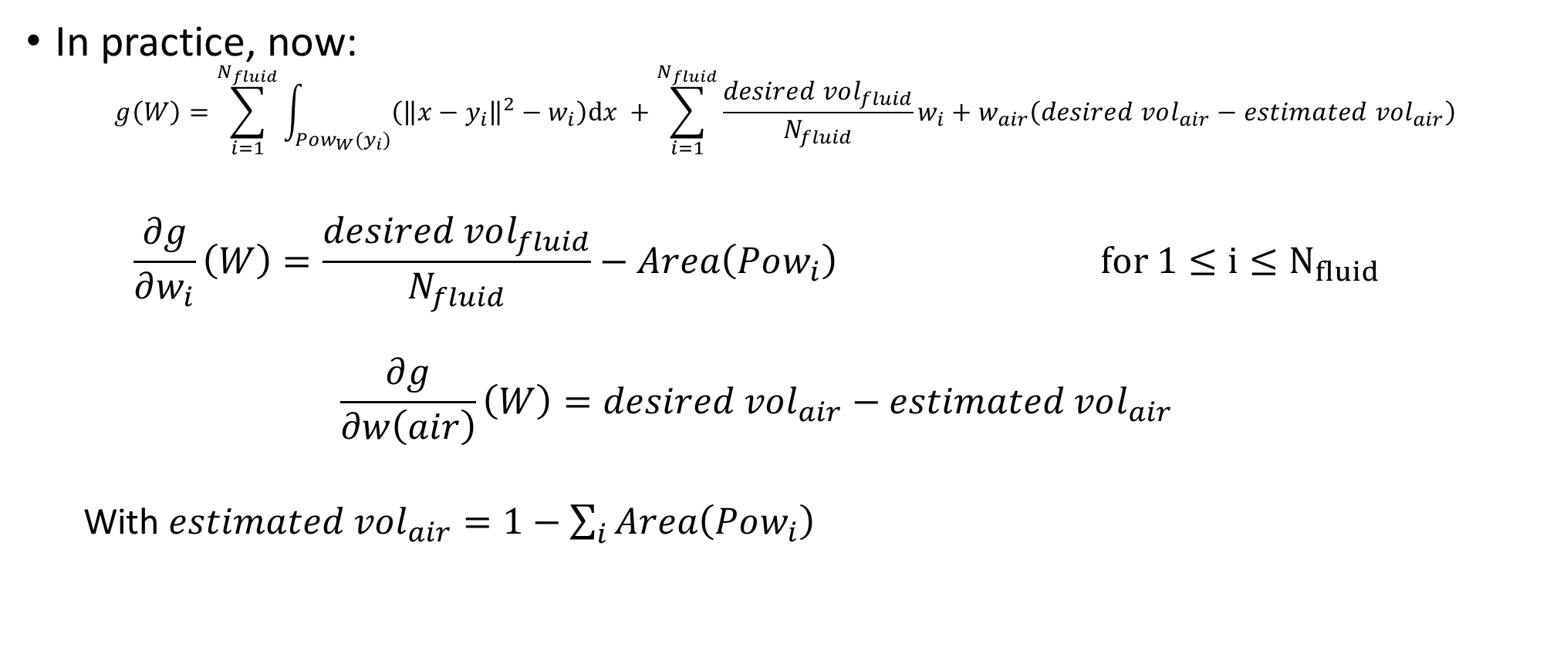
Fluids with Optimal Transport
In practice, now:
$$g\left(W\right)=\sum_{i=1}^{N_{fluid}}{\int_{Pow_{W}(y_{i})}{\left({\left\|x−y_{i}\right\|}^{2}−w_{i}\right)\text{d}x }}+\sum_{i=1}^{N_{fluid}}{\frac{desired vol_{fluid}}{N_{fluid}}w_{i}}+w_{air}\left(desired vol_{air}−estimated vol_{air}\right)$$
$$\frac{∂g}{∂w_{i}}\left(W\right)=\frac{desired vol_{fluid}}{N_{fluid}}−Area\left(Pow_{i}\right) for 1≤i≤N_{fluid}$$
$$\frac{∂g}{∂w\left(air\right)}\left(W\right)=desired vol_{air}−estimated vol_{air}$$
With $estimated vol_{air}=1−\sum_{i}{Area\left(Pow_{i}\right)}$

Slide 24
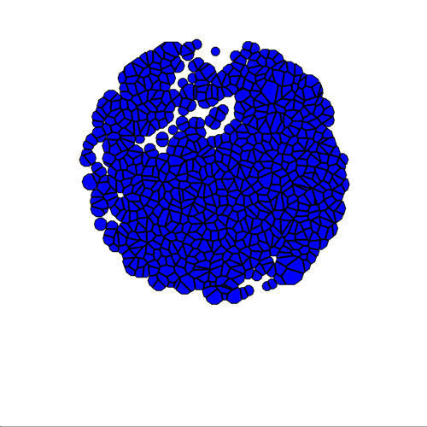
Fluids with Optimal Transport
$N_{fluid}=700, N_{air}=1$, 1 sec/frame

Slide 25
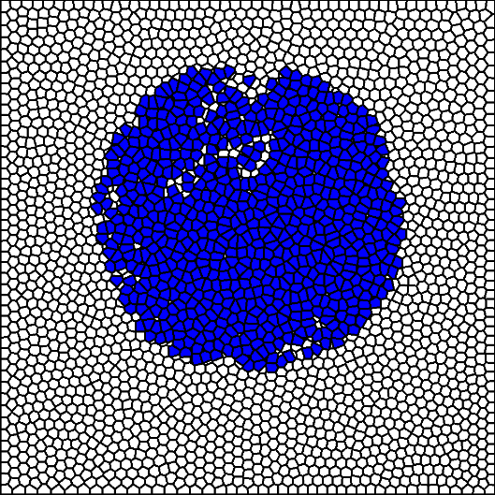
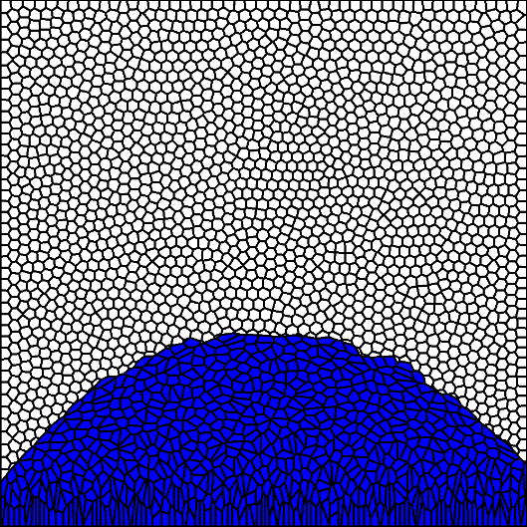
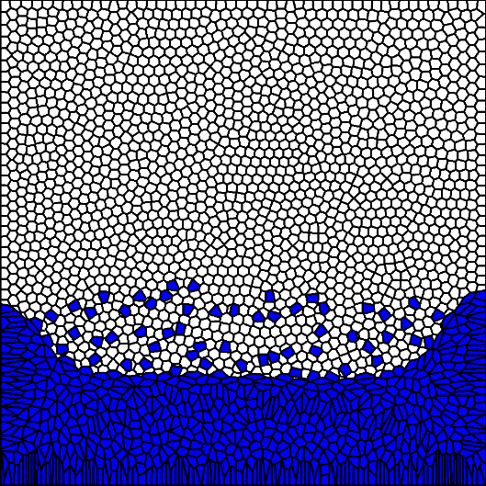
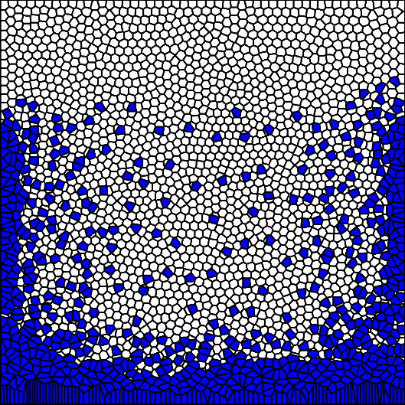
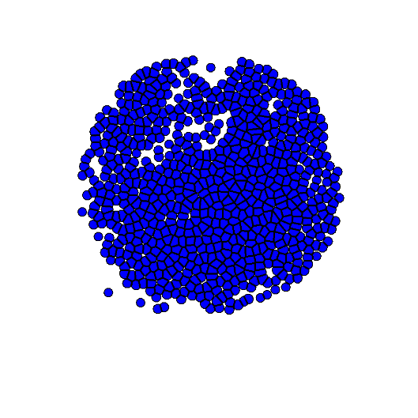
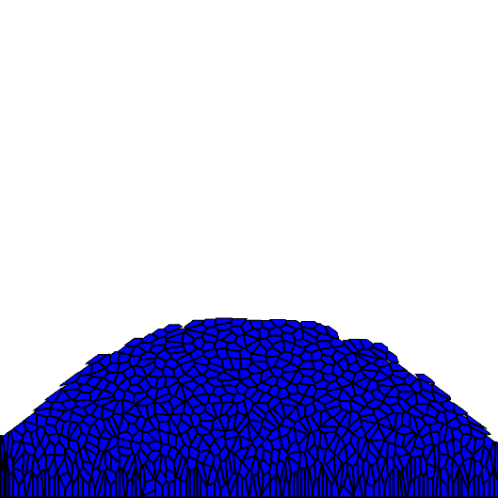
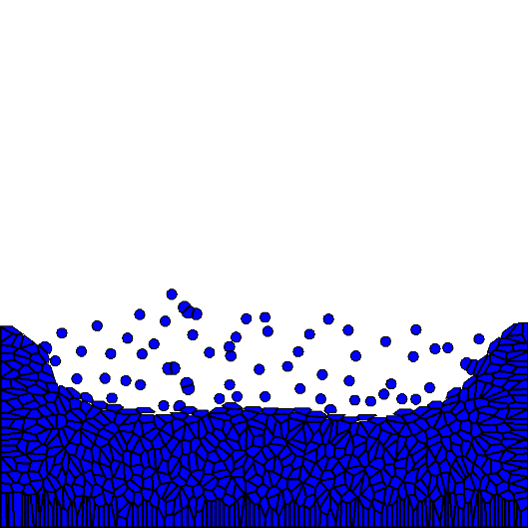
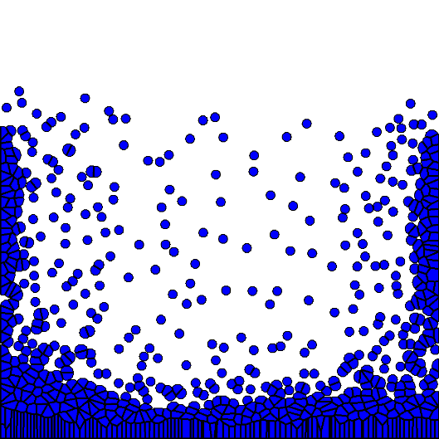
Fluids with Optimal Transport

Slide 26


Fluids with Optimal Transport
Corresponds to transporting optimally volume_fluid among volume_total
Partial optimal transport
x
x
x
x
x
x
x
x
x
x
x
x
$$units produced=area$$
$$units produced≤area$$

Slide 27
Regularized optimal transport

Slide 28
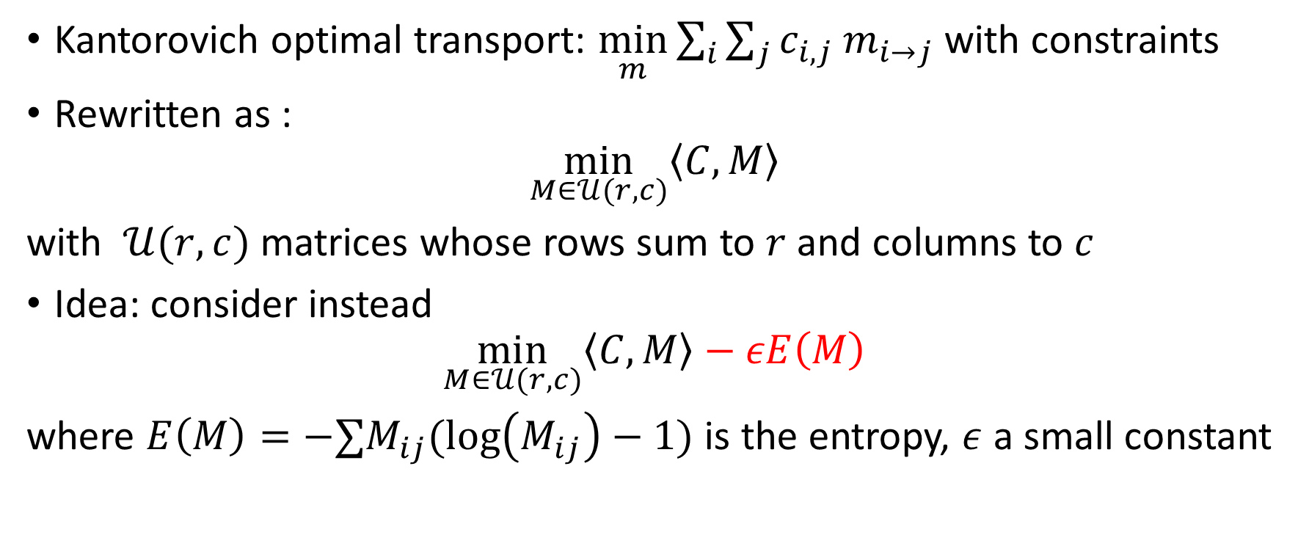
The Sinkhorn algorithm
Kantorovich optimal transport: $\min_{m}{\sum_{i}{\sum_{j}{c_{i,j} m_{i→j}}}}$ with constraints
Rewritten as :
$$\min_{M∈𝒰(r,c)}\left\langle C, M\right\rangle$$
with $𝒰(r,c)$ matrices whose rows sum to $r$ and columns to $c$
Idea: consider instead
$$\min_{M∈𝒰(r,c)}\left\langle C, M\right\rangle −εE\left(M\right)$$ where $E\left(M\right)=−∑M_{ij}(\log\left(M_{ij}\right)−1)$ is the entropy, $ε$ a small constant
Iterative Bregman Projections for Regularized Transportation Problems [Benamou et al. 2014]
Sinkhorn Distances: Lightspeed Computation of Optimal Transport [Cuturi 2013]

Slide 29
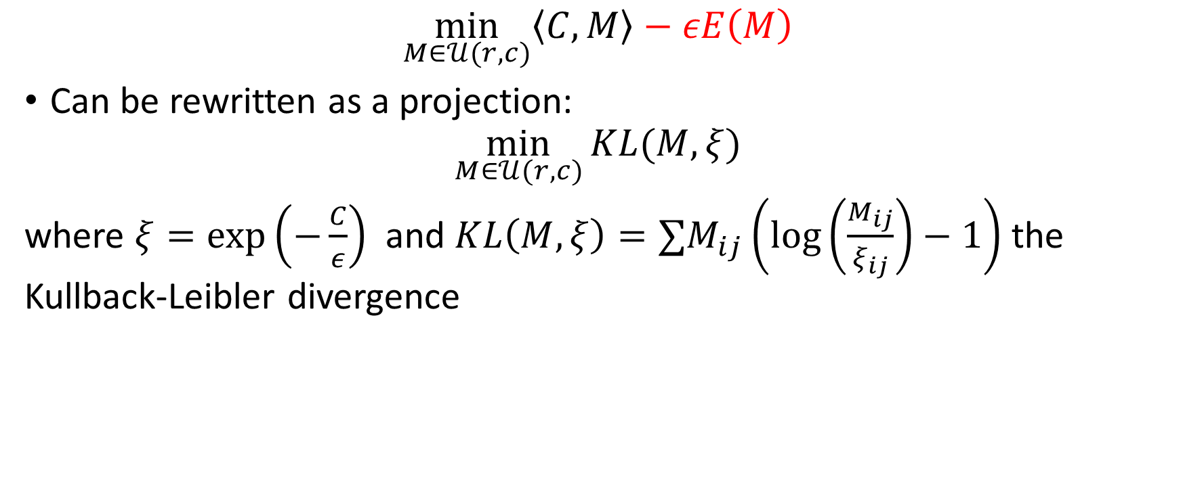
The Sinkhorn algorithm
$$\min_{M∈𝒰(r,c)}\left\langle C, M\right\rangle −εE\left(M\right)$$
Can be rewritten as a projection:
$$\min_{M∈𝒰(r,c)}{KL(M, ξ)}$$ where $ξ=\exp\left(−\frac{C}{ε}\right)$ and $KL\left(M, ξ\right)=∑M_{ij}\left(\log\left(\frac{M_{ij}}{ξ_{ij}}\right)−1\right)$ the Kullback-Leibler divergence

Slide 30

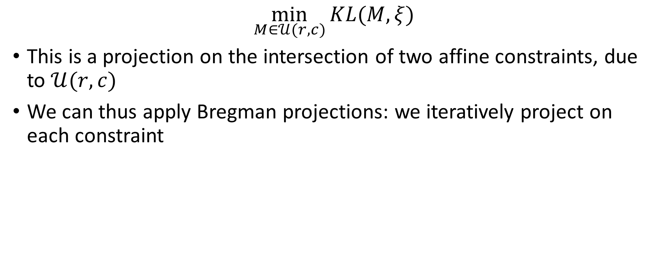
The Sinkhorn algorithm
$$\min_{M∈𝒰(r,c)}{KL(M, ξ)}$$
This is a projection on the intersection of two affine constraints, due to $𝒰(r,c)$
We can thus apply Bregman projections: we iteratively project on each constraint
x $ξ$

Slide 31
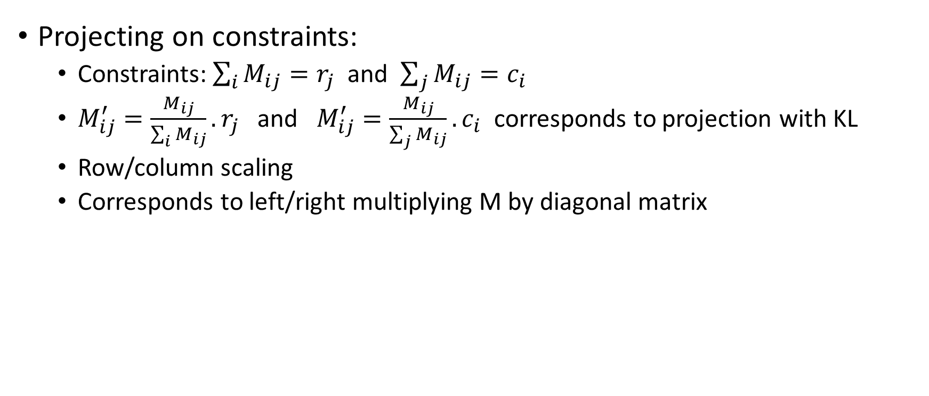
The Sinkhorn algorithm
Projecting on constraints:
Constraints: $\sum_{i}{M_{ij}}=r_{j}$ and $\sum_{j}{M_{ij}}=c_{i}$
$M_{ij}^{′}=\frac{M_{ij}}{\sum_{i}{M_{ij}}}.r_{j}$ and $M_{ij}^{′}=\frac{M_{ij}}{\sum_{j}{M_{ij}}}.c_{i}$ corresponds to projection with KL
Row/column scaling
Corresponds to left/right multiplying M by diagonal matrix

Slide 32

The Sinkhorn algorithm
We can thus apply Bregman projections: we iteratively project on each constraint
We obtain the algorithm:
$u^{(n)}=\frac{f}{ξ v^{(n)}}$
$v^{(n+1)}=\frac{g}{ξ^{T} u^{(n)}}$
$M=diag\left(u^{\left(n\right)}\right)ξ diag(v^{(n)})$

Slide 33

The Sinkhorn algorithm
We realize that $ξ v^{(n)}$ can be computed efficiently
E.g., if $c\left(x,y\right)= {\left\|x−y\right\|}^{2}$, $ξ_{ij}=\exp\left(−\frac{{\left\|x_{i}−x_{j}\right\|}^{2}}{ε}\right)$
Then $ξ v^{(n)}$ is just a Gaussian convolution
So, it is a separable operator, and efficiently done in high-dimension
Convolutional Wasserstein Distances: Efficient Optimal Transportation on Geometric Domains [Solomon et al. 2015]

Slide 34

The Sinkhorn algorithm
Generalized to compute displacement interpolation and barycenters
$b_{s}^{(0)}=1 ∀s$
for $ℓ=0 …L$
$a_{s}^{(ℓ)}=\frac{p_{s}}{K b_{s}^{(l−1)}} ∀s$
$p\left(λ\right)= \prod_{s}{ {\left(K^{T}a_{s}^{\left(ℓ\right)}\right)}_{}^{λ_{s}}}$
$b_{s}^{(ℓ)}= \frac{p(λ)}{K^{T} a_{s}^{(ℓ)}} ∀s$

Slide 35

The Sinkhorn algorithm
Issues
Unstable as regularization decreases
Computations in log-domain
Number of iterations should increase as regularization decreases
Multiscale computations
$W_{ε}(f,f)≠0$
${\tilde{W}}_{ε}\left(f,g\right)=W_{ε}\left(f,g\right)−\frac{1}{2}(W_{ε}\left(f,f\right)+W_{ε}(g,g))$

